Slide 1
Exercise 16c
Operation at Minimum Level
Phase 6
Aim - as syllabus
Copyright Marcus Furniss 2019

Slide 2
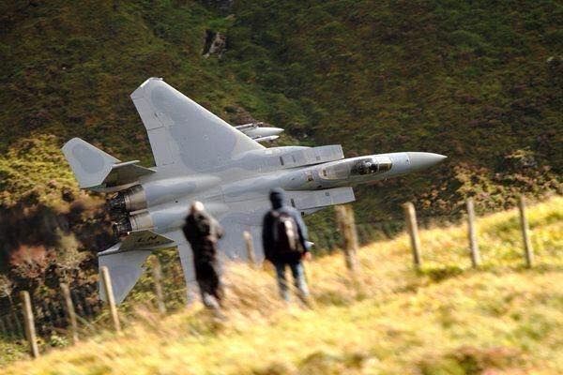
Why Fly at Low Level?
Low level is generally considered to be 1000’AGL or lower
Poor weather
  Low cloud base (often together with poor visibility)
To stay beneath controlled airspace
  VFR transit lanes such as the Manchester LLR
To inspect a field for a precautionary landing

Slide 3
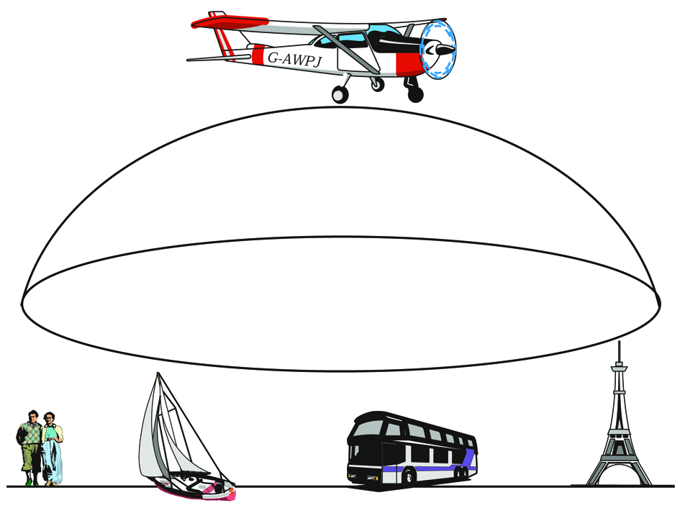
The Law – Rule 5 of the ANO
An aircraft shall not fly closer than 500’ to any
  Person
  Vehicle
  Vessel
  Structure
Exceptions
  The purpose of saving life
  Landing and taking off in accordance with normal aviation practice
NB. SERA now states aircraft must fly a minimum 500 feet above ground level
However CAA allow old rule above to remain

Slide 4

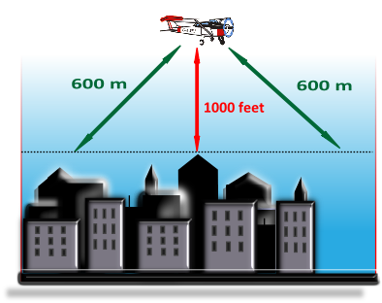

Low Flying (1000 feet Rule)
Except for helicopters, aircraft shall
not fly over a congested area below a
height that will permit the aircraft to:
land clear of the congested area in the event of the failure of the power unit, or
below 1,000 feet above the highest fixed obstacle within 600m of the aircraft; whichever is the higher.
1000 ft
600 m
600 m
You are exempted from this rule if taking off from or landing at a licensed or government aerodrome in accordance with normal aviation practice.

Slide 5
Flight at Low Level – AVOID OBSTACLES!
Study chart and intended track before descending
  Note elevation of ground
  Note obstacles enroute
  Allow 5nm either side of intended track
  Remember man-made obstructions below 300’ AGL are not necessarily shown on chart
  Establish a working minimum safe altitude (ideally +700’ AGL)
Beware rising ground/narrow valleys ahead
  Always ensure there is route back and space to turn
Get an accurate QNH
Consider slowing down
  Creates more time to navigate/less stress
  Lower flaps to increase forward visibility/lower stall speed

Slide 6
Flight at Low Level – AVOID OTHER AIRCRAFT!
With low cloud base, expect all other air traffic to be at your level
  This may now also include military aircraft
An active look out with a constant scan is essential

Slide 7
Flight at Low Level – ENGINE FAILURE
Be aware of possibility of engine failure at all times
Always be aware of the wind direction
Keep within gliding range of safe areas
  This may mean changing track, adding to navigational workload
Have an active plan
  Constantly update as progress is made, again adding to navigational workload

Slide 8
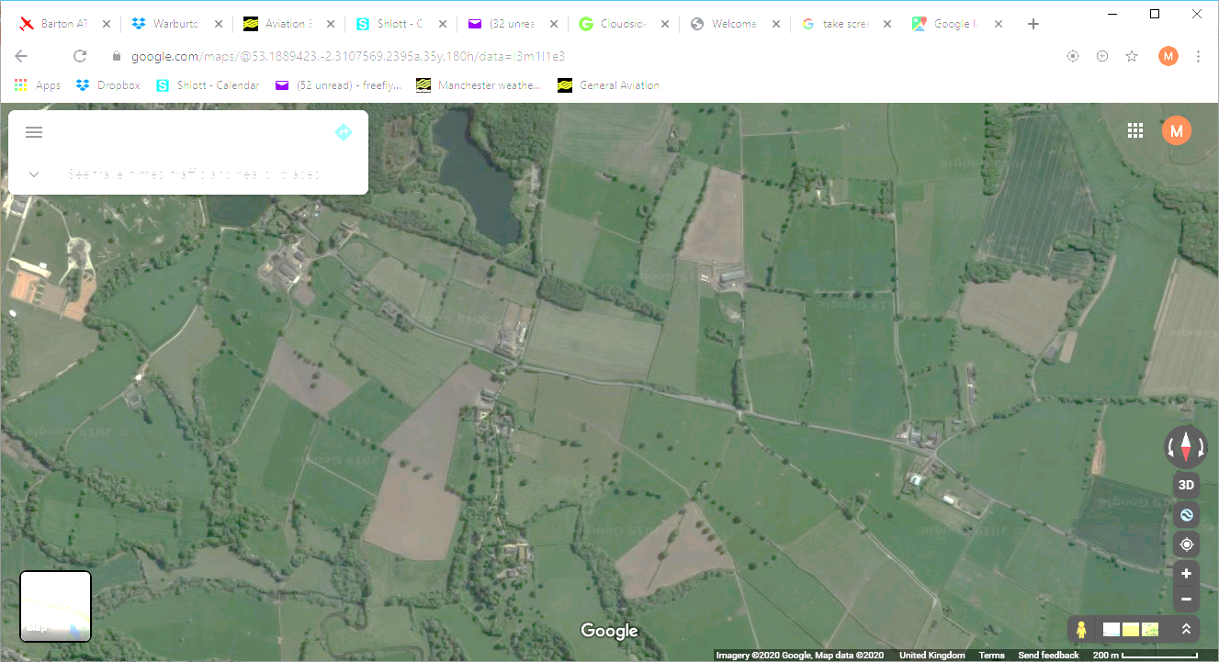
Keep in balance during turns and monitor safe A/S
Try to limit turns to 30 deg bank angle
Flaps as appropriate
Operation at minimum level
Wind
Intended Track
800 AGL

Slide 9
Keep in balance during turns and monitor safe A/S
Try to limit turns to 30 deg bank angle
Flaps as appropriate
Operation at minimum level
Wind
Intended Track
800 AGL

Slide 10
Keep in balance during turns and monitor safe A/S
Try to limit turns to 30 deg bank angle
Flaps as appropriate
Operation at minimum level
Wind
Intended Track
ENGINE FAILURE
800 AGL

Slide 11
Keep in balance during turns and monitor safe A/S
Try to limit turns to 30 deg bank angle
Flaps as appropriate
Operation at minimum level
Wind
Intended Track
800 AGL

Slide 12
Keep in balance during turns and monitor safe A/S
Try to limit turns to 30 deg bank angle
Flaps as appropriate
Operation at minimum level
Wind
ENGINE FAILURE
Intended Track
800 AGL

Slide 13
Keep in balance during turns and monitor safe A/S
Try to limit turns to 30 deg bank angle
Flaps as appropriate
Operation at minimum level
Wind
Intended Track
800 AGL

Slide 14
The Effect of wind at Low Level
LIFT
SINK
HILL
ROTOR
Wind will cause lift, sink and turbulence as it flows over terrain
  Don’t fly immediately downwind of hills in a strong wind

Slide 15
The Effect of wind at Low Level
Wind will cause drift
  Allow plenty of distance if manoeuvring near obstacles (M’s ears)
When flying low in strong wind, your movement in relation to the ground can mislead the pilot and lead to mistaken control inputs
Wind
A/C appears to skid
A/C appears to slip and accelerate
ATTENTION - balance and A/S
A/C appears to slow down

Slide 16

Navigation at Low Level
Navigation is more difficult at low level
VRP
Terrain
Use more waypoints, especially if visibility reduced
Consider following a line feature, even if this increases the distance flown
  More sure of position
  Reduces navigational workload allowing more time for safety considerations

Slide 17
If workload gets too high…STOP
Operation at minimum level can be very demanding
  Navigation challenging with reduced visibility
  Active planning for potential engine failure
  Obstacle and terrain avoidance
  Observing rule 5
  Managing drift and turbulence in strong wind – maintain balance
  Constant lookout with potentially high traffic density
If workload too high, and/or if weather deteriorating
  Divert to an airfield close by
  Make a precautionary landing
Pushing on into poor weather and rising ground = ACCIDENT

Slide 18
Joining the circuit at low level and poor visibility
Get airfield information
  Before entering ATZ
  If non-radio get info before flight but be prepared it may have changed
Plan approach to join to minimise conflict with circuit traffic
  Ideally from dead side
  Regular position reports or as instructed by FISO
  Fly a tight circuit (traffic dependant) to maintain visual contact with airfield

Slide 19
Flying low level - Practice
Plan simple route, following line features
Work out MSA and (imaginary) cloud base
Initially focus on Navigation and forced landings
If strong wind, drift exercises including Mickeys Ears
Practice low level joins
Practice precautionary landings (see next brief 16b)

Slide 20
Airmanship
Obstacle and terrain avoidance – check chart and lookout
Set altimeter to accurate QNH
Consider suitable airspeed and flap configuration
Navigation challenging with reduced visibility
Constant lookout with potentially high traffic density
Active planning for potential engine failure
Observing rule 5
Managing drift and turbulence in strong wind – keep in balance
Make early decision to divert or carry our precautionary landing

Slide 21
Exercise 16c
Operation at Minimum Level
Questions?

Slide 22
Exercise 16b
Precautionary Landings
Aim - as syllabus

Slide 23
Precautionary Landings – Why?
A precautionary landing can sensible for various reasons
Flight into deteriorating weather
  Press-on-itus (Goal Fixation) = ACCIDENT
When lost
  If all other means prove fruitless then a precautionary landing may be prudent
Running low on fuel
  If mistake is made in pre-flight calculations then early decision to divert of carry out precautionary landing
Fading daylight – as above
Feeling ill
Early decision is best before situation become critical

Slide 24
Precautionary Landing Procedure
Asses time available
  Abbreviated or full procedure
Assess wind direction and strength
  As per 16a forced landing without power
Select landing area
  As per 16a forced landing without power
  With power and time permitting we have wider choice
Inspection runs should be made before committing to land

Slide 25
Precautionary Landing Procedure
Fly left hand circuit around potential field at 500 AGL
  If sure of ground elevation this should be judged visually

Slide 26
Precautionary Landing Procedure
Wind
First Inspection
500’ AGL
1
500’ AGL

Slide 27
Precautionary Landing Procedure
Fly left hand circuit around potential field at 500 AGL
  If sure of ground elevation this should be judged visually
1st inspection run 500’ AGL
  Assess suitability of field
  Check for obstacles not on chart especially on approach and climb out – eg cables - before descending on 2nd run
  Note visual reference points

Slide 28
Precautionary Landing Procedure
Wind
Second Inspection
250’ AGL
1
2
500’ AGL

Slide 29
Precautionary Landing Procedure
Fly left hand circuit around potential field at 500 AGL
  If sure of ground elevation this should be judged visually
1st inspection run 500’ AGL
  Assess suitability of field
  Check for obstacles not on chart especially on approach and climb out – eg cables - before descending on 2nd run
  Note visual reference points
2nd inspection run 250’ AGL
  Check for smaller obstacles – ie fences – assess drift

Slide 30
Precautionary Landing Procedure
Wind
Thrid Inspection
100’ AGL
1
2
3
500’ AGL

Slide 31
Precautionary Landing Procedure
Fly left hand circuit around potential field at 500 AGL
  If sure of ground elevation this should be judged visually
1st inspection run 500’ AGL
  Assess suitability of field
  Check for obstacles not on chart especially on approach and climb out – eg cables - before descending on 2nd run
  Note visual reference points
2nd inspection run 250’ AGL
  Check for smaller obstacles – ie fences – assess drift
3rd inspection run 100’ AGL
  Fly approach as if intending to land – level off at 100’ and look closely at landing surface
After another circuit land using short/soft field techniques

Slide 32
Precautionary Landing Procedure
Wind
500’
250’
100’
Land after 3 inspection circuits
1
2
3
500’ AGL

Slide 33
Precautionary Landing Procedure
Land after holding off as long as possible
  Touch down at minimum speed on unknown surface
Use only gentle braking
After stopping do not taxi
  Field may have poor surface
After landing secure aircraft and contact landowner/inform destination
Shorten procedure;
  If rough running engine treat as forced landing without power
  If airframe problems, fly below Va avoiding manoeuvres that may overstress airframe

Slide 34
Before taking off again
Make sure that condition are suitable to complete flight
Make sure intended take off area is long enough
Consider aircraft weight, wind, surface, met conditions and climb out path
Get permission of the landowner
Get permission from Mainair
IF IN DOUBT – DON’T!

Slide 35
Airmanship
Lookout
  Military traffic, drones
Make the decision to land early
Be mindful of low flying rules and minimise nuisance during practice
  Will practice procedure at Barton

Slide 36
Exercise 16b
Precautionary Landings
Questions?

