Slide 1
Exercise 9a
Turning Flight: Level turns up to 30 angle of bank
Phase 2
o
Aim - as syllabus
Copyright Marcus Furniss 2019

Slide 2
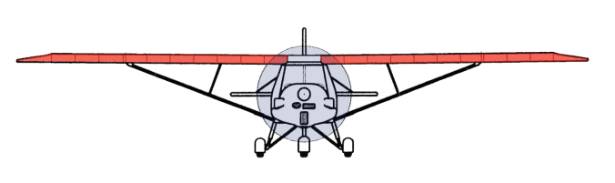

Exercise 9a - Level turns up to 30 bank angle
o
L
V
L
Extra lift required to maintain level flight
L = W
W
W
To turn an A/C we need to bank the A/C
Vertical component of lift (V) is reduced – V does not equal W
A/C will descend and speed will increase

Slide 3
Exercise 9a - Level turns up to 30 bank angle
o
L
V
L
L = W
V = W
Turn Force
W
W
HOW?
We to need increase the lift
⬆ AOA (stick back) = ⬆ Lift + ⬆ Drag
Possibly more power to maintain A/S
More lift also increases Turn Force
As bank angle ⬆, Turn Force ⬆, which ⬆ rate of turn
As airspeed ⬆, rate of turn ⬇ for same bank angle

Slide 4
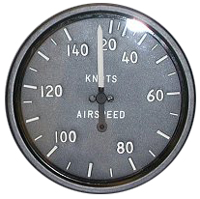
Exercise 9a - Level turns up to 30 bank angle
o
Entry
Reference point for turn exit/heading
  (initially 360 deg)
Level flight + target A/S (Stall Speed increases in a turn)
  Target 80 KTs
3. Look out – lift wing to clear blind spot then look opposite direction round into turn
opp
turn
4. Roll into turn, coordinating aileron + rudder. Centralise aileron and rudder at desired bank angle to stop rolling movement and balance turn
5. Stick back slightly (⬆ AOA) to maintain height (ref horizon, checked with VSI and Altimeter)
6. If necessary increase power to maintain A/S (ASI)

Slide 5
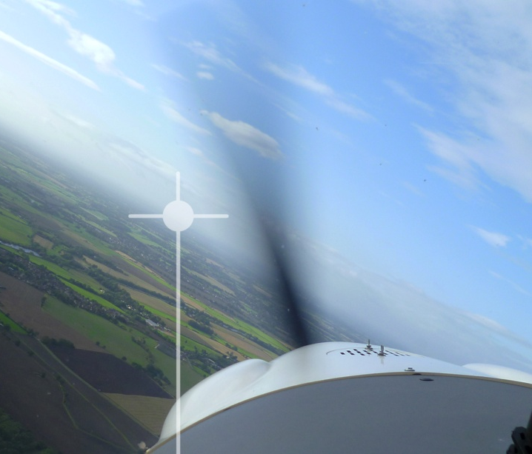
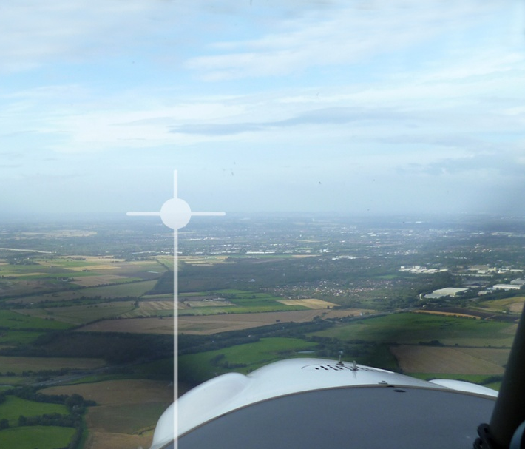
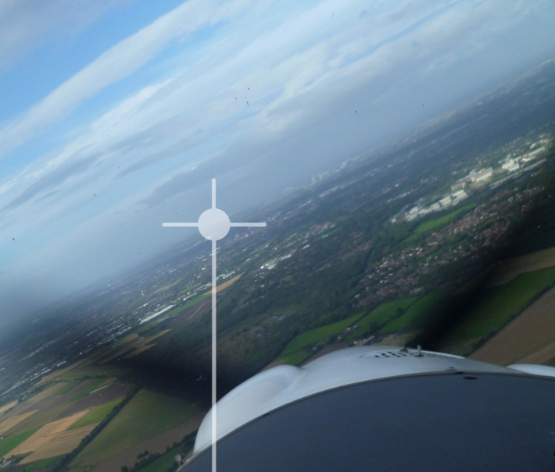
Exercise 9a - Level turns up to 30 bank angle
o
Side by side a/c have a different horizon perspective for left and right turns
The horizon is the primary reference for both bank and pitch
DO NOT CHASE THE INSTRUMENTS

Slide 6
Exercise 9a - Level turns up to 30 bank angle
o
Maintain level turn
Monitor | Input | Reference
Bank | Roll (Stick) | Horizon
Balance | Yaw (Rudder) | Balance Ball
Height | Pitch (Stick) | Horizon, VSI, ASI
Airspeed | Power (Throttle) | ASI
Work Cycle
Lookout into turn
Attitude – check pitch attitude/bank angle
Instruments – check Airspeed, balance, VSI, ALT
Turn is transient manoeuvre so no need to trim

Slide 7
Exercise 9a - Level turns up to 30 bank angle
o
To exit the turn onto a specific reference
Exit
Anticipate reference point (20 deg)
Roll out of turn, coordinating aileron + rudder. Centralise when wings level
Relax back pressure on column to attain the level flight attitude
Adjust power as required
  Turn is transient manoeuvre so no need to trim

Slide 8
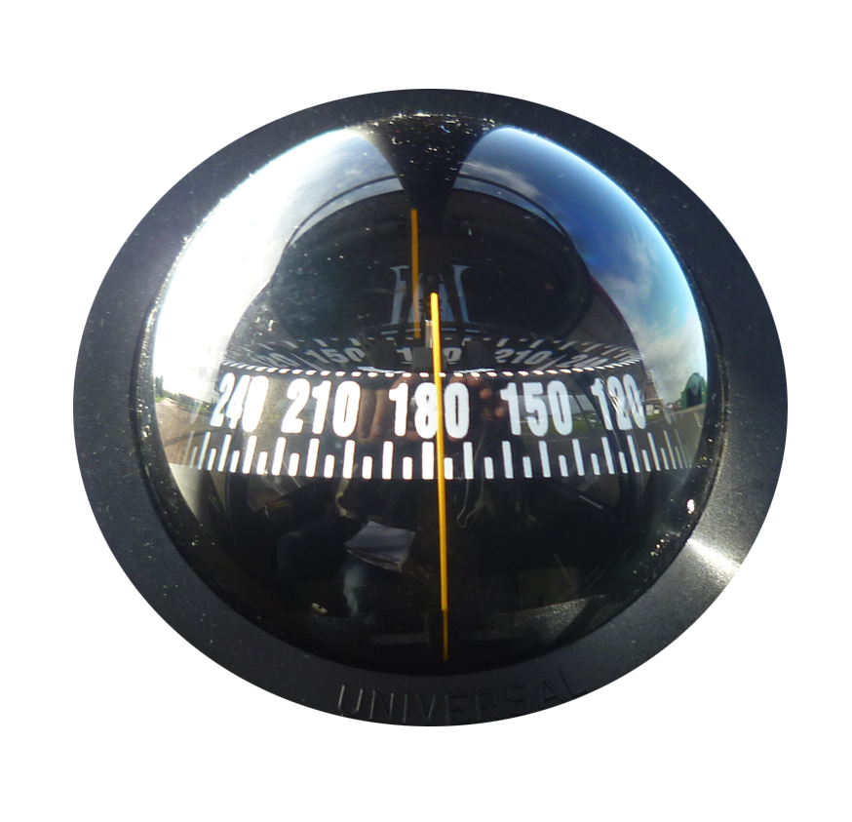
Exercise 9a - Level turns up to 30 bank angle
o
Magnetic compass
When rolling out on a new northerly or southerly compass heading you need to be aware of its turning errors - UNOS
Use the compass before turning
  to decide on the direction of turn, the required heading change and estimate reference point to roll out on
Any adjustments can be done once the turn is complete and compass is steady

Slide 9
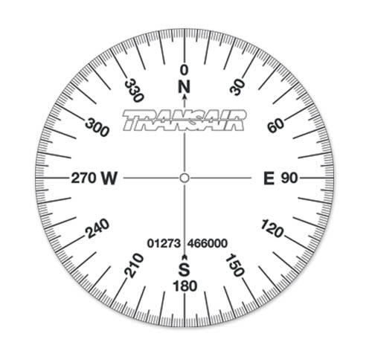
Exercise 9a - Level turns up to 30 bank angle
o
Magnetic compass
Example
Aiming
Point
Aiming
Point
Estimating 90/180 deg - L to R wingtip

Slide 10
Exercise 9a - Level turns up to 30 bank angle
o
Airmanship
Lookout - opposite direction round to direction. Lift wing to clear blind spots
Lookout – ask passenger to help with lookout
Lookout use LAI work cycle
Drift - do not drift over congested areas or into controlled airspace

Slide 11
Exercise 9a
Turning Flight: Level turns up to 30 angle of bank
Phase 2
o
Questions?

Slide 12
Exercise 9b
Climbing and descending turns up to 30 angle of bank
Phase 2
o
Aim - as syllabus

Slide 13
Exercise 9b – Climbing and descending turns
Climbing turn
No additional power therefore nose lower (stick) to maintain A/S
Climb performance reduces (lift force is tilted to produce turning force)
  use shallow bank angles /manage A/S to maintain good climb rate
Over banking tendency when climbing - ‘hold off bank’ (covered in ground school)
Gliding turn
No power therefore nose lower (stick) to maintain A/S
Increased rate of descent (lift force is tilted to produce turning force)
Under banking tendency when descending - ‘hold on bank’
Keep in balance – different amounts of rudder may be required for R + L turns in a climb and descent due to altered Slipstream.

Slide 14
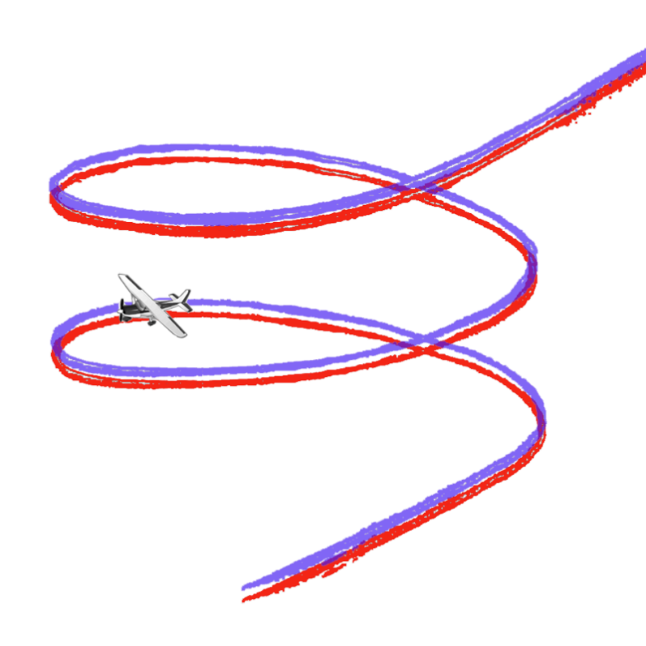
Exercise 9b – Climbing and descending turns
Straight
Climb
Climbing turn from straight climb and recovered to straight climb
Lookout
Initiate turn
Hold off bank
If necessary additional back stick pressure to maintain 70KT
Balance
Turning
Climb
Straight
Climb

Slide 15
Exercise 9b – Climbing and descending turns
Straight
Descent
Gliding turn from straight glide and recovered to straight glide
Lookout
Initiate turn
Hold on bank
If necessary additional back stick pressure to maintain 70KT
Balance
Turning
Descent
Straight
Descent

Slide 16
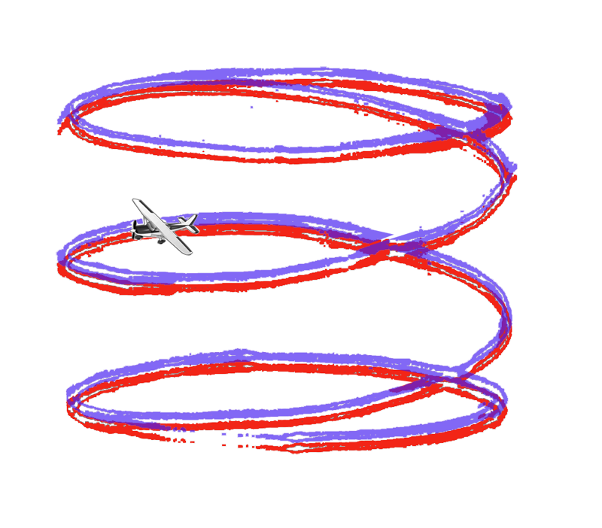
Exercise 9b – Climbing and descending turns
Climbing turn from level turn, recovered to level turn
Lookout
Full power, raise nose
Hold off bank, balance
Maintain airspeed 70KT using pitch
To return to level turn
Lower nose, reduce power
Adjust power, pitch, rudder
Level Turn
Turning
Climb
Level turn

Slide 17
Exercise 9b – Climbing and descending turns
Gliding turn from level turn, recovered to level turn
Lookout
Lower nose, reduce power
Hold on bank, balance
Maintain airspeed 70KT using pitch
To return to level turn
Increase power, raise nose,
Adjust power, pitch, rudder
Level Turn
Turning
Descent
Level Turn

Slide 18
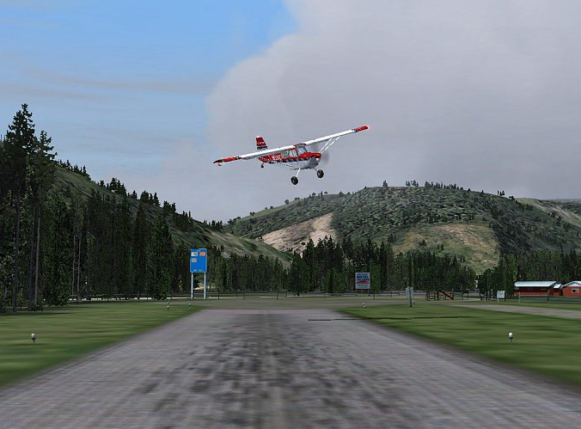
Exercise 9b – Climbing and descending turns
Side slipping in a descending turn
Used to increase rate of descent
When established in gliding turn;
  Move stick towards lowered wing
  Apply rudder opposite to turn direction

Slide 19
Exercise 9b – Climbing and descending turns
Airmanship
Lookout - opposite direction round to direction. Lift wing to clear blind spots
Lookout - when climbing descending, above/ below/ forwards/ backwards
Drift - do not drift over congested areas or into controlled airspace
Airspace - down wind/ above/ below. Do not enter without appropriate clearance
Engine - T’s +P’s in climb, warm engine during descent every 500ft

Slide 20
Exercise 9b
Climbing and descending turns up to 30 angle of bank
Phase 2
o
Questions?

