Slide 1
Exercise 16d Action in the Event of a Fire
Phase 6
Aim - as syllabus
Copyright Mainair Flying School 2022

Slide 2
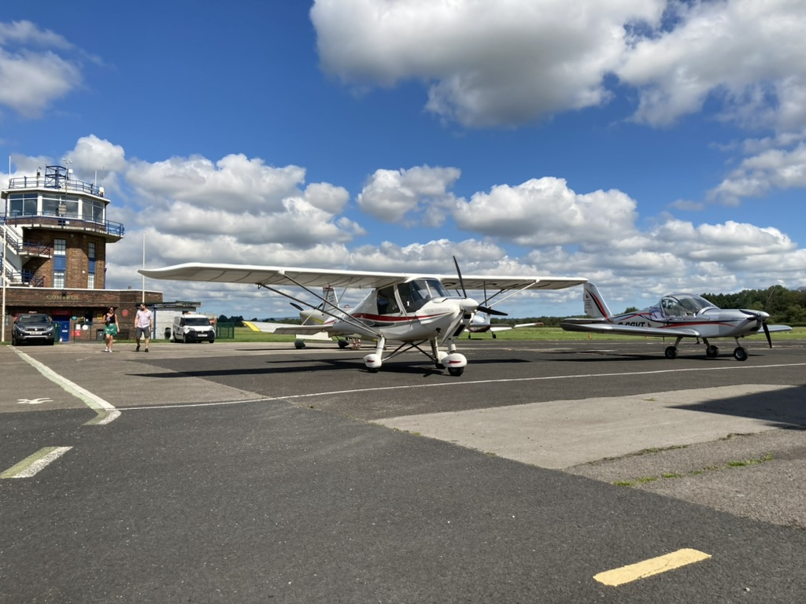
ACTION IN THE EVENT OF A FIRE

Slide 3
The following system failures relate to the Ikarus C42, EV 97 Eurostar, and the Rotax 912 engine. The following advice may also be used on other types if applicable.

Slide 4
ENGINE FIRE ON THE GROUND (Engine start up)
Causes
Flooding the engine caused by excess fuel entering the cylinders
Engaging the starter motor for too long causing it to overheat

Slide 5
ENGINE FIRE ON THE GROUND
Actions - Fuel fire or Electrical fire
Whether engine started or not
1. Turn the fuel OFF
2 .Turn the ignition switches OFF
3. Turn Master Switch OFF
4. Vacate the aircraft
5. Use a fire extinguisher if required and available

Slide 6
ENGINE FIRE ON THE GROUND (Taxiing)
Actions
Turn the aircraft so any flames or smoke are blown away from the cockpit.
Turn the fuel OFF. This will starve the fire of fuel in the case of a fuel fire.
Allow the engine to stop due to lack of fuel.
If time permits call ATC who can deploy Fire and Rescue.
Switch OFF the Master Switch/Charging Switch.
Vacate the aircraft and move any passengers upwind away from the aircraft.
Use a fire extinguisher if possible

Slide 7
ENGINE FIRE IN THE AIR
Engine fires in the air are a rare occurrence
Actions
Turn OFF the fuel.
Allow the engine to stop.
Turn OFF the ignition switches.
Carry out a Forced Landing Procedure.
Note
A high rate of descent may be required in order to land the aircraft as soon as practically possible. Flaps should be used and a sideslip should be considered to increase the rate of descent and to keep the flames away from the cockpit area.

Slide 8
COCKPIT FIRE IN THE AIR
Cause
Cockpit fires are generally caused by an electrical problem with the wiring or a component fault.
Actions
Turn OFF the Master Switch. (Be aware that the RPM gauge will not work)
Open the air vents
If the fire or smoke persists then carry out a forced landing but it may not be necessary to turn the engine off. Only turn the engine off if it is contributing to the fire

Slide 9
BEFORE TURNING THE MASTER SWITCH OFF
Before turning off the Master Switch, time and workload permitting a Mayday call should be made to ATS
The priority for the pilot is to
FLY THE AEROPLANE AT ALL TIMES
AIRSPEED, AIRSPEED, AIRSPEED

Slide 10
All of the previous notes should be used as a guide as different situations will require different actions
Always consult the aircraft POH

Slide 11
Exercise 16d Actions in the Event of a Fire
Questions?

Slide 12
Exercise 16e Systems Failures
Phase 6
Aim - as syllabus
Copyright Mainair Flying School 2022

Slide 13
SYSTEM FAILURES
DISCUSSION ONLY

Slide 14
HATCH OR DOOR OPENING ON TAKE OFF
If a door/canopy comes open on the take off roll and providing that there is enough stopping distance, then the take off should be abandoned and the aircraft stopped
If the take off cannot be abandoned, then climb the aircraft at the normal speed and complete a circuit.
UNDER NO CIRCUMSTANCES SHOULD A PILOT OR PASSENGER UNDO THEIR SEATBELT IN ORDER TO REACH A DOOR OR CANOPY THAT HAS COME OPEN

Slide 15
HATCH OR DOOR OPENING IN FLIGHT
A door opening in flight can be a distraction rather than dangerous
It will become dangerous if the pilot forgets to fly the aircraft
In the case of an Ikarus it would be better to leave the door open and land at the earliest opportunity
In the case of a Eurostar the safety catch should stop the canopy from opening more than a couple of inches
UNDER NO CIRCUMSTANCES SHOULD A PILOT OR PASSENGER UNDO THEIR SEATBELT IN ORDER TO REACH A DOOR OR CANOPY THAT HAS COME OPEN

Slide 16
BROKEN THROTTLE CABLE
MOST 3 AXIS AIRCRAFT WITH THE ROTAX 912 ENGINE FITTED HAVE TWO THROTTLE CABLES, ONE TO EACH CARBURETOR
If one cable snaps then the carburettor with the broken cable will automatically go to full power
When the power is reduced to cruise power setting the aircraft engine will run extremely rough and a severe vibration will go through the airframe due to the inbalance on the carburetors

Slide 17
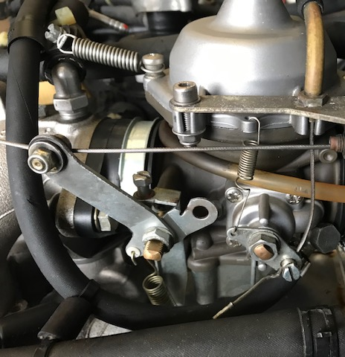
BROKEN THROTTLE CABLE
Carburetor showing the throttle in the open position

Slide 18
BROKEN THROTTLE CABLE ACTION TO BE TAKEN
Immediately apply full power to allow the engine to run smoothly
Continue to the airfield overhead if just departed or divert to the nearest airfield if in the cruise
After levelling out radio a PAN/MAYDAY call informing ATS of the suspected problem
When traffic permits a Forced Landing will have to be made by turning off both ignition switches. Leave the throttle on full power
DO NOT TURN OFF THE FUEL
If the approach is misjudged, then ignition switches can be put back on and the engine restarted. The aircraft can then climb away for another attempt
After landing under NO circumstances should the engine be started or any attempt to taxy
Caution - be aware of the maximum continuous RPM for the engine
If the aircraft can be flown in level flight be aware of the VA speed especially if the conditions are turbulent
Be aware of airspace above as the aircraft may want to continue climbing

Slide 19
JAMMED THROTTLE
If a throttle jams on full power, then the procedure for a broken throttle cable should be followed

Slide 20
BRAKE FAILURE
If the aircraft suffers a brake failure, then the ignition switches should immediately be turned off and the aircraft steered away from any obstacles
NOTE - For this very reason when parking, the aircraft should not be taxied into a position behind other aircraft Always stop with a clear area ahead

Slide 21
STEERING FAILURE
If the aircraft suffers from a steering failure, then the aircraft should be stopped and the ignition turned off

Slide 22
HEATER FAILURE
NO WARM AIR!
If the heater fails and no warm air is coming out on a cold day, then consider returning to the airfield if close by or diverting
Close air vents if needed and if safe descend into warmer air
Be aware that Hypothermia can set in very quickly in cold conditions

Slide 23
HEATER FAILURE
TOO MUCH HOT AIR!
A heater can also fail in the hot position causing a very high temperature in the cockpit
If this happens return to the airfield if close by or divert
Open air vents as needed

Slide 24
HEATER FAILURE
CARBON MONOXIDE POISONING
Carbon monoxide poisoning can be caused by a leak from the exhaust into the heating system
If CO poisoning is suspected immediately turn off the heater and open all air vents. Check the CO detector
Land the aircraft as soon as safely possible

Slide 25
OIL PRESSURE GAUGE FAILURE
The oil pressure gauge is electrically operated and generally very reliable
It can fail in one of two ways
If the gauge shows 7 bar (max limit) then it is usually the sender unit
If the gauge shows 0 bar, then it could be the sender unit or the gauge itself
If it did show 0 bar and there was a problem with the engine, then the engine would seize in about 30 seconds - Refer to Exercise 16a

Slide 26
IGNITION SWITCH FAILURE
If an ignition switch fails, then this can show up on a magneto check by no drop in the RPM when a switch is turned to the off position
If the engine does not shut down when the switches are turned off, then there are two ways to shut the engine down
Keep the throttle on idle and pull the choke out. This should flood the engine causing it to cut out
With the throttle on idle turn off the fuel selector switch. The engine should stop after about 2 minutes

Slide 27
REPLACING FUSES
If a fuse is suspected to have blown on an electrical circuit, then the pilot should be aware of where the spare fuses are kept and only replace them with the aircraft at a safe level. E.G. 1500 feet AGL
No attempt should be made to change a fuse with the aircraft at low level, unless absolutely necessary

Slide 28
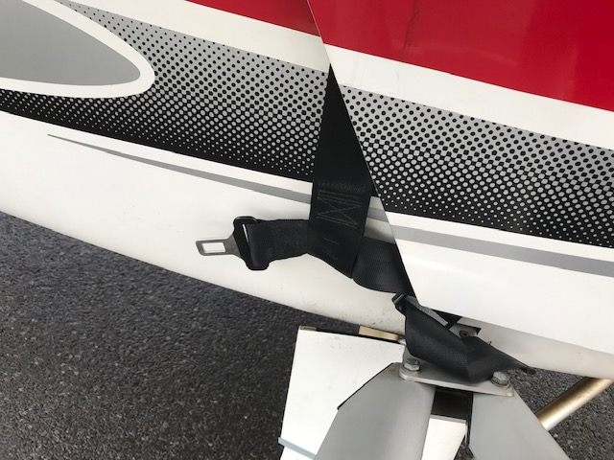
SEAT BELT TRAPPED

Slide 29
SEAT BELT TRAPPED
If a seat belt is trapped and part of the webbing is outside the aircraft, it can cause a loud banging noise on the fuselage
ACTION
Land the aircraft and rectify the problem
Do not attempt to open the door or canopy in flight

Slide 30
FLAP FAILURE
If the aircraft has a flap failure and the flaps cannot be deployed down, then a flapless approach and landing should be carried out.
This will be practiced in Exercise 13
If the flaps cannot be retracted, then return to the airfield and land the aircraft in the configuration that the flaps are stuck in.
In the case of electrically operated flaps, leave the flap switch in the position that the flaps have failed in and climb to a safe height before trying to rectify the problem
If the aircraft suffers from an asymmetrical flap deployment, then this will show as a roll towards the failed flap when the flaps are deployed.
In this instance then, set the flaps to a symmetrical position and land the aircraft in that configuration. (This would usually be flapless)

Slide 31
AIRSPEED INDICATOR FAILURE.
The ASI can fail by failing completely i.e. 0 speed, stuck in one position, overreading or underreading
These failures are usually a fault within the ASI itself or a blockage/leakage in the pitot static system
Blockages are usually by small objects like insects or water in the pitot system
If the pitot system becomes blocked it will show the ASI underreading on a descent, e.g. on the final approach or overreading as the aircraft climbs
Flying the aircraft without the ASI can be practiced with an instructor (usually in Exercise 13 and 16e)

Slide 32
ALTIMETER AND VSI FAILURE
Altimeters should be checked prior to take off by setting the QNH which will then indicate the airfield elevation or the QFE which should indicate 0
If the altimeter is suspected of failing in flight, then the level shown can be checked against the GPS altitude readout
VSI failure are not usually a problem in VFR flight and any suspected failure reported to the aircraft owner after landing

Slide 33
ALTERNATOR FAILURE
IKARUS C42
If the alternator fails, then this will cause the low voltage warning light to come on and the warning buzzer to sound (if fitted)
EV97
If the alternator fails, then this will show as low charging on the voltage indicator.
ACTIONS IF IN FLIGHT
Switch off any electrical equipment that is not needed e.g strobes, landing light and electric fuel pump
A radio call should be made to ATS to inform them of the problem as the radio and transponder will be using the battery power and may fail as the battery drains
A check of the charging fuse should be made
Turning the master switch on and then back on after a few seconds might cure the issue
NOTE - Turning the Master Switch on does NOT stop the engine

Slide 34
TRIM RUNAWAY OR FAILURE
Ikarus C42
Trim runaway can be caused by a failure of the switch or by the pilot inadvertently pressing the trim switches by incorrectly holding the control column
If the switch fails in the nose high or low position this can mean extreme pressure has to be applied to maintain level flight
Action
Hold the aircraft in the desired attitude and land as soon as practically possible
This can be practiced in Exercise 13 and 16e

Slide 35
CONTROL COLUMN FAILURE
This is a extremely rare occurrence but can be practiced in Exercise 16e with an instructor.
The attitude can be adjusted by using the trim and power settings

Slide 36
AILERON CONTROL FAILURE
This is an extremely rare occurrence but can be practiced in Exercise 16e with an instructor.
The roll control can be controlled by using the further effects of the rudder.

Slide 37
UNDERCARRIAGE ISSUES
Punctures
If the aircraft has a suspected puncture on the main wheels, then a landing should be performed with a landing on the good wheel and keeping the weight off the punctured wheel by use of the ailerons.
The aircraft may require excessive rudder movements in order to keep the aircraft going straight when the punctured wheel touches down.
If the aircraft has a suspected nose wheel puncture, then a landing using a soft field landing technique should be used and touching down as slow as possible.

Slide 38
FLUTTER
Flutter is a rare occurrence on microlights
It is usually caused by excessive play in the trim tab or the trim tab cable or linkage breaking and generally at high speed but can also occur at low speed on certain types
Symptoms
Violent shaking of the control column in pitch and the airframe vibrating
Actions
Slow the aircraft down to an airspeed where the flutter stops or to a safe slow cruise speed where the flutter reduces
Use flaps with caution as this could make the flutter worse. A flapless landing may be the preferred option

Slide 39
RADIO FAILURE
Symptoms
Radio not coming on
Radio on but unable to hear or transmit
Flutter is a rare occurrence on microlights
The majority of ‘radio failures’ are caused by pilots being unfamiliar with the radio settings or a headset issue
Actions
If the radio is on but the pilot cannot hear any acknowledgement of a call

Slide 40
RADIO FAILURE
Actions
If the radio is on but the pilot cannot hear any acknowledgement of a call
Check that the right frequency is selected
Check the volume control is turned up
Check that the headset jack plugs are in the sockets correctly
Check that the ATS is open
Check that you are within range of the ATS and that you are in line of sight (Terrain). Consider climbing if safe and airspace allows

Slide 41
RADIO FAILURE
If the radio is not coming on
Check that you are operating the power switch correctly. Some radios turn off if the power switch is depressed for too long
Check if the aircraft has a separate Comms switch to power the avionics
Check the fuse. Only change attempt to change the fuse at a safe level and in straight and level flight

Slide 42
RADIO FAILURE
If the problem persists then squawk the radio failure transponder code 7600
Consider diverting
Where possible join the airfield overhead and check the signal square for the runway in use and circuit direction
Watch for light signals directed at the aircraft from the control tower

Slide 43
STUCK PTT SWITCH
If a PTT switch is suspected to be stuck, then check that the transmit signal symbol on the radio is not on
If it is then transmit over the radio to ATC informing them that you have a stuck PTT and that you will be going non radio
Squawk 7600 if fitted with a transponder
COMMON CAUSES
Ikarus Pilot having their finger inadvertently on the PTT switch on the centre control column
EV97 Pilot or passenger having a map over the top of the control column and resting it on the PTT switch

Slide 44
PASSENGERS
Passengers can react in different ways especially if they have not been in a small aircraft before
Passengers must be briefed before flight on any safety issues
In flight some passengers may feel ill due to turbulence or motion sickness. Ensure you carry sickbags for their use
Check that they are not too cold/hot
Open the air vents if they feel unwell
Avoid carrying out extreme manoeuvres e.g. Advanced Turns or stalls

Slide 45
PASSENGERS
Some passengers can become very excited (especially children) when flying
Try and keep them calm and do not become distracted from flying the aircraft especially when taking off and landing and when flying near controlled airspace

Slide 46
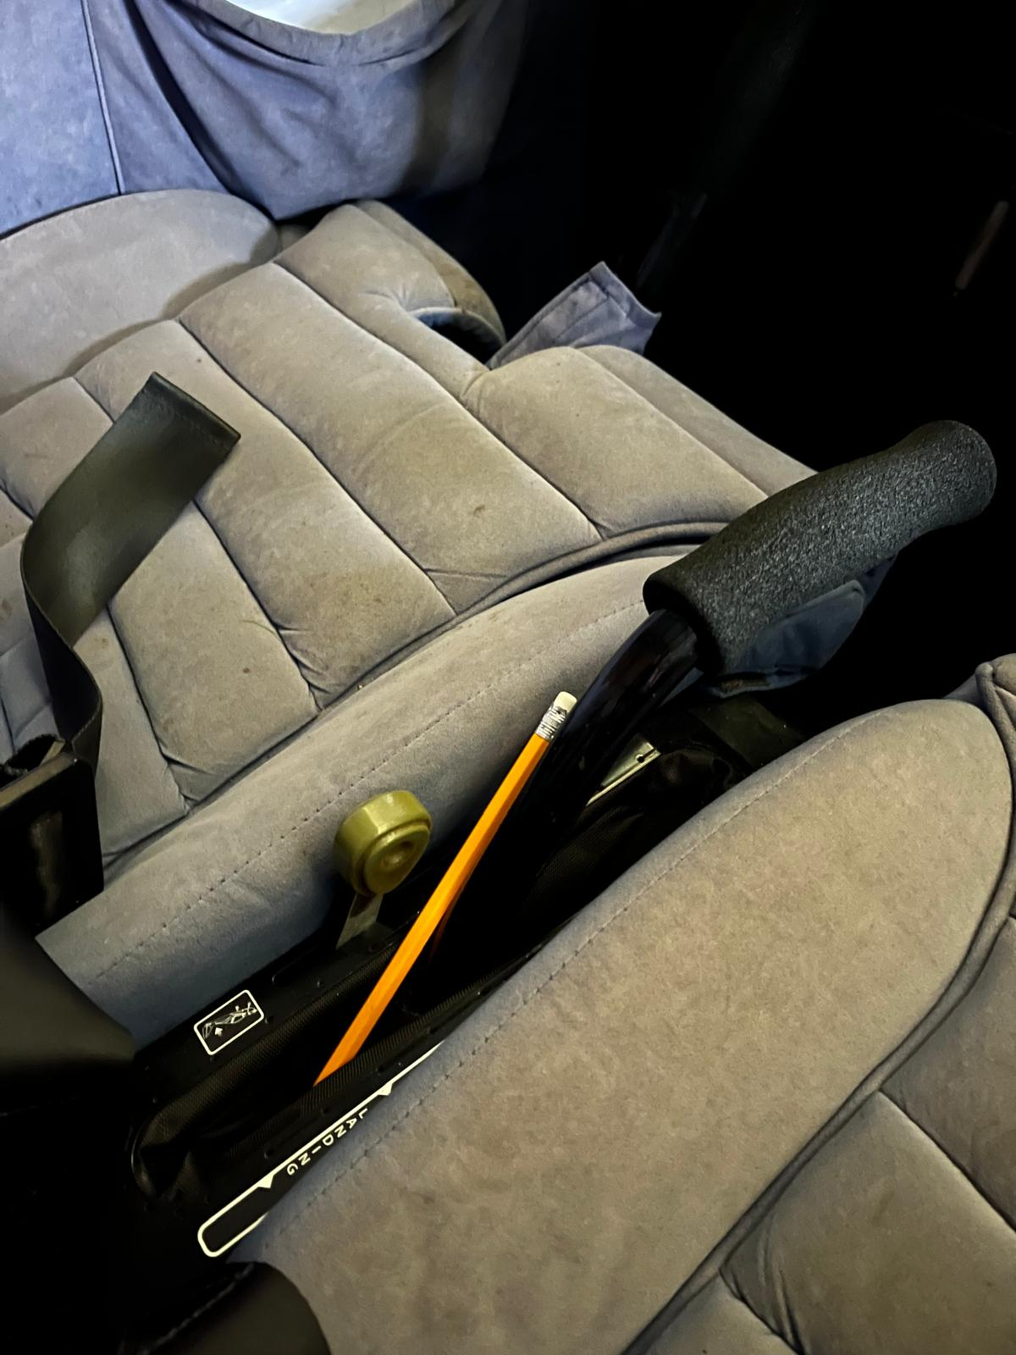
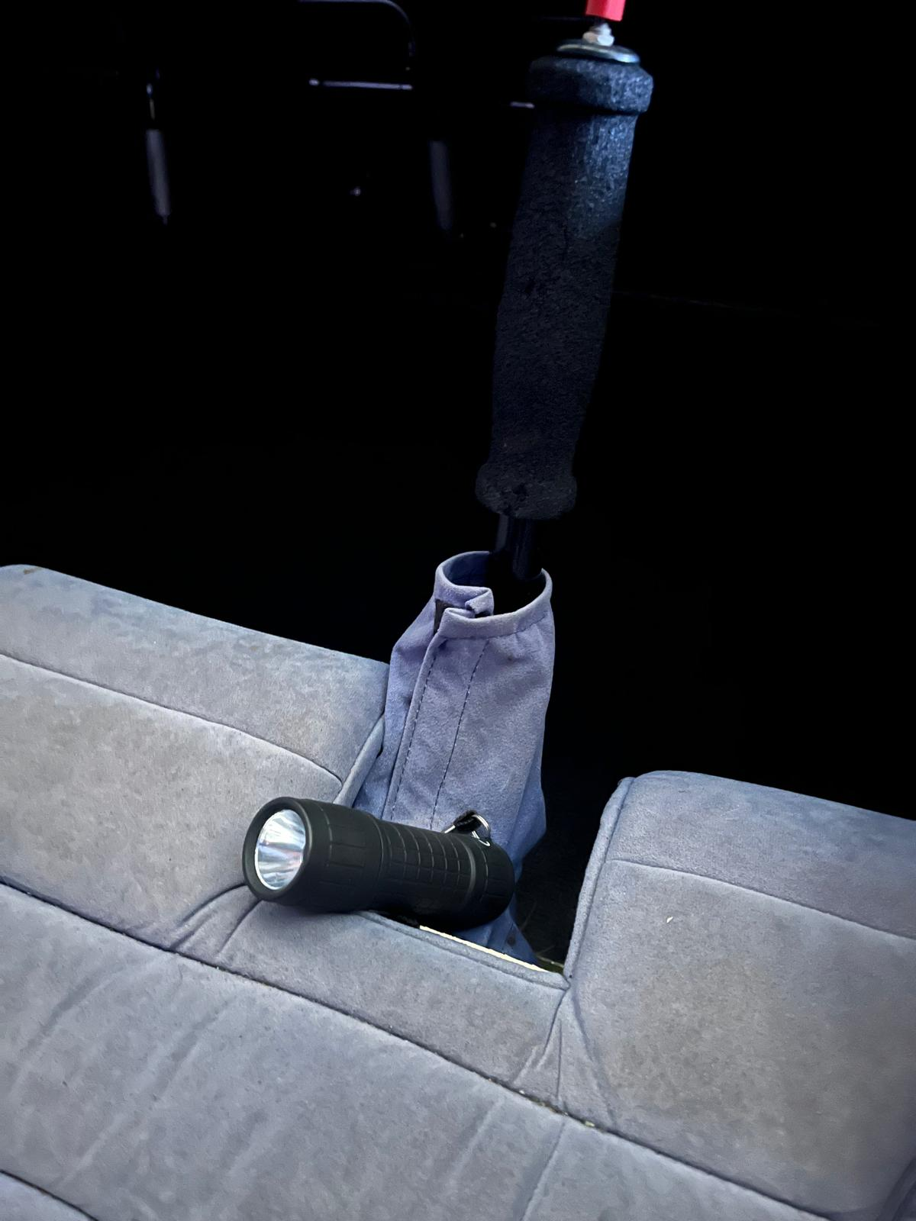
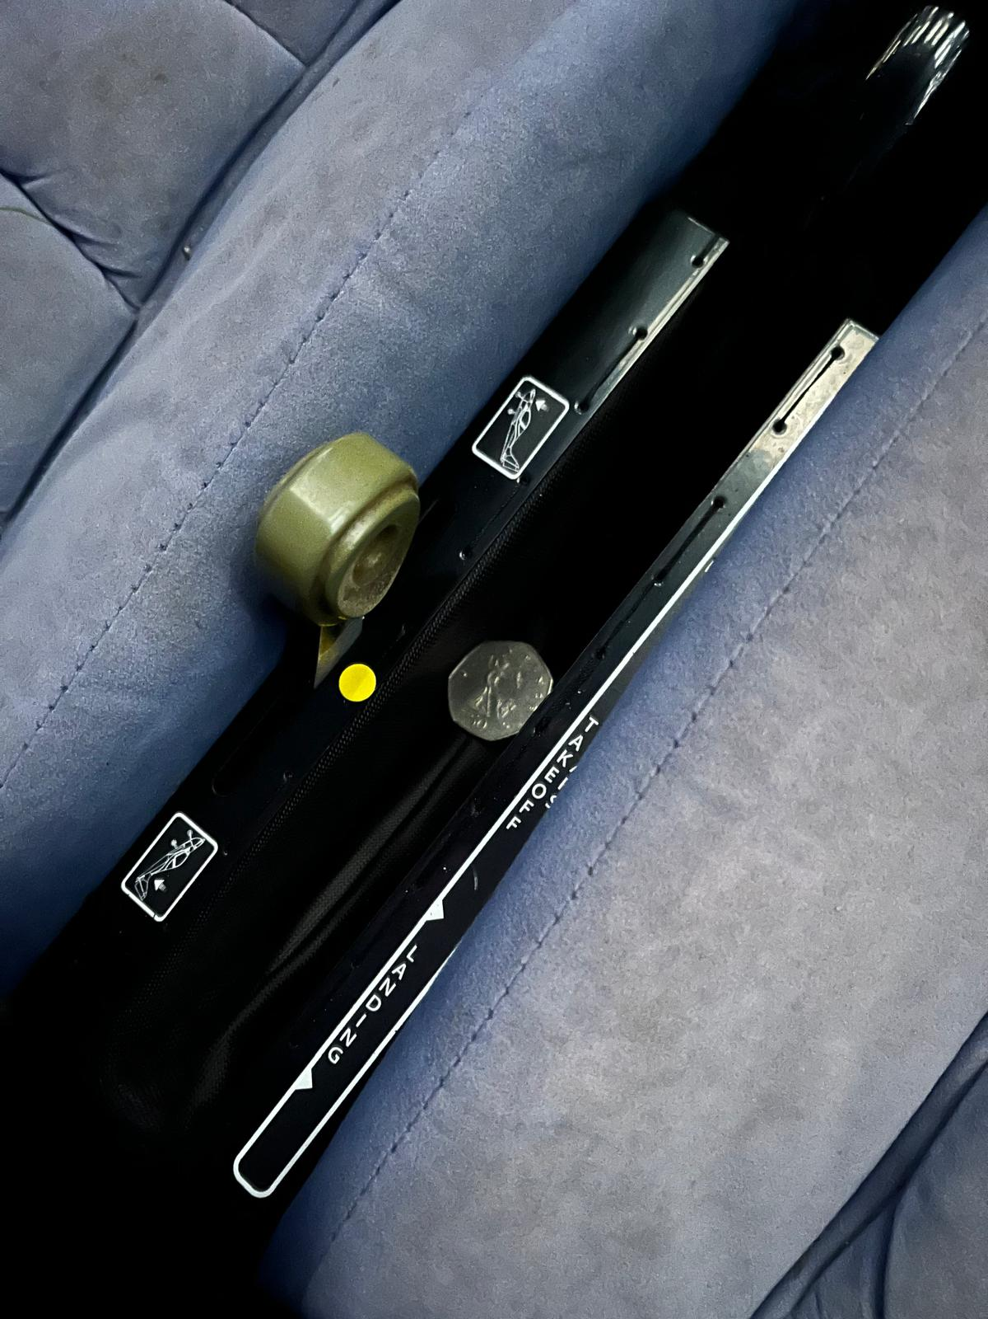
LOOSE OBJECTS

Slide 47
LOOSE OBJECTS
All loose objects must be secured in the baggage area or the door/side pockets
Take extra care with pens and pencils, and all coins should be in a zipped pocket
Check that jackets and coats are not trapped in doors or hatches and make sure that any toggles on clothing are not caught around any control such as the trim lever on the Eurostar

Slide 48
SUMMARY
There are many types of emergencies, and it is not possible to cover every eventuality
All the emergencies mentioned, and the actions should be used as a guide and adapted for the individual scenario
When dealing with an emergency if possible then deal with a problem whilst in straight and level flight and at a safe level
If another pilot who is familiar with the aircraft is a passenger, then ask them to try and solve the problem whilst you fly the aircraft or ask them to fly and you look at the problem

Slide 49
SUMMARY
Do not rush in to making hasty decisions. E.g. a low voltage warning light will not stop the engine, so do not rush the circuit or landing. A door that has come open will cause a distraction and a draft, but the aircraft will still fly
Remember to fly the aircraft at all times
Airspeed, Airspeed, Airspeed

Slide 50
TRY TO STAY CALM

Slide 51
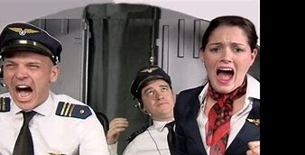
SORT THE PROBLEM OUT IN A CALM WAY

Slide 52
REASSURE YOUR PASSENGERS

Slide 53
Exercise 16e Systems Failures
Questions?

