Slide 1
Exercise 7 Basic Climbing and Descending
Phase 2
Aim - as syllabus
Copyright Marcus Furniss 2019

Slide 2
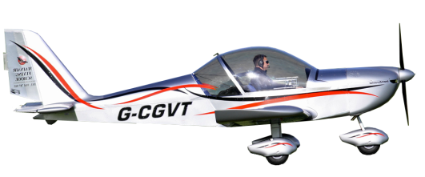
Theory – Forces in Level Flight
LIFT
LIFT = WEIGHT
THRUST = DRAG
DRAG
THRUST
WEIGHT

Slide 3
Theory – Forces in a Climb
LIFT
A component of WEIGHT acts with DRAG
Therefore more THRUST required
THRUST
DRAG
This component of weight opposes LIFT
WEIGHT
This component of weight acts with DRAG

Slide 4
Theory – Forces in a Glide Descent
LIFT
DRAG
A component of weight acts as THRUST
This component of weight opposes LIFT
WEIGHT
This component of weight adds to THRUST

Slide 5
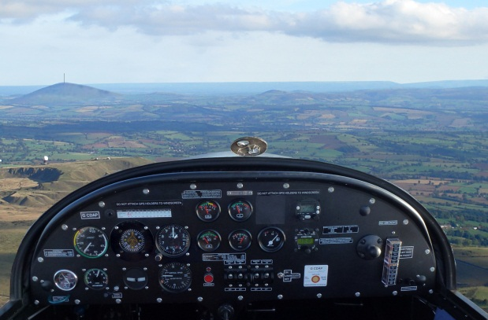
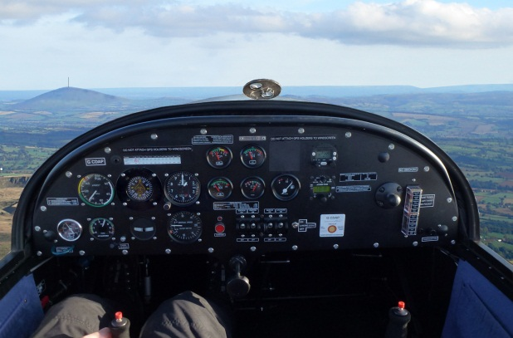
Climb Entry
P
Power – Increase power and balance with rudder
A
Attitude – Raise nose to climbing attitude and hold
T
Trim – Adjust attitude to achieve correct airspeed, hold and trim
EV-97 80 MPH
C42 70KTS
EV-97 90 MPH
C42 80 KTS
Reference Point – due high nose attitude use VRP to left to maintain straight flight

Slide 6
To Level Off
Anticipate – initiate the levelling-off procedure at 20 feet before the target altitude
A
Attitude – Lower nose to level attitude and hold until target airspeed achieved
P
Power – reduce to cruise RPM and balance with rudder
T
Trim –
Adjust attitude to achieve correct airspeed, adjust power to maintain height then hold and trim
EV-97 90 MPH
C42 80KTS
20 feet
EV-97 80 MPH
C42 70KTS

Slide 7
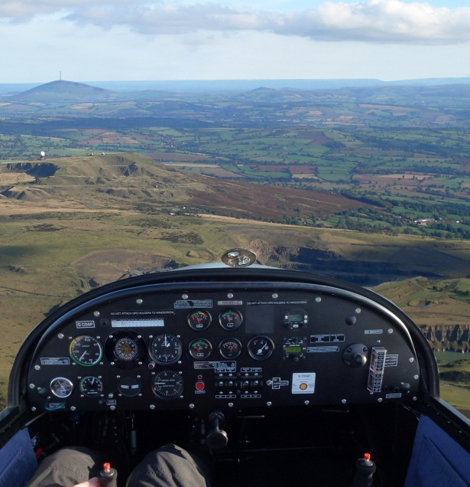
Descent Entry Target descending airspeed is lower than cruise airspeed
P
Power Reduce as required and keep in balance with rudder
A
Attitude
Hold initially as airspeed reduces to target airspeed and then lower to descent attitude
T
Trim
Adjust attitude /power to achieve correct airspeed and descent rate, then hold and trim
EV-97 90 MPH
C42 80 KTS
EV-97 80 MPH
C42 70KTS

Slide 8
Descent Entry Target descending airspeed is same or greater than cruise airspeed Also default technique for older microlight types
A
Attitude Lower nose to descent attitude and hold
P
Power
Reduce as required, use rudder to keep balance
T
Trim
Adjust attitude /power to achieve correct airspeed and descent rate, then hold and trim
EV-97 90 MPH
C42 80 KTS
EV-97 90 MPH
C42 80 KTS

Slide 9
To Level Out from a Descent
Anticipate – initiate the levelling-off procedure at 50 feet before the target altitude
P
+
Power – Increase power and balance with rudder
A
Attitude – Raise nose to level attitude and hold
T
Trim – Adjust attitude to achieve correct airspeed and trim
50 feet
EV-97 80 MPH
C42 70KTS
EV-97 90 MPH
C42 80 KTS

Slide 10
To enter a Climb from a Descent
P
+
Power – Increase power and balance with rudder
A
Attitude – Raise nose to climbing attitude and hold
T
Trim – Adjust attitude to achieve correct airspeed then hold and trim
EV-97 80 MPH
C42 70KTS
EV-97 80 MPH
C42 70KTS

Slide 11
To enter a Descent from a Climb
A
Attitude Lower nose to descent attitude and hold
P
Power
Reduce as required, use rudder to keep balance
T
Trim
Adjust attitude /power to achieve correct airspeed and descent rate, then hold and trim
If flaps are extended nose attitude will need to be lower to maintain airspeed
In transition period aircraft may be significantly out of trim
EV-97 80 MPH
C42 70KTS
EV-97 80 MPH
C42 70KTS

Slide 12
Cruise climb and descent
Cruise Climb
Less than full power will reduce angle and rate of climb
Less stress on engine and lower noise
Lower nose attitude for same airspeed
Cruise descent
Adding power will reduce angle and rate of descent
Used to control descent rate (ie when approaching to land)
Keeps engine warm during prolonged descent

Slide 13
Airmanship
Lookout – all around and above before and during climb, all around and below before and during descend
Blindspots – lower nose every 500 feet in climb, check below with pax lookout before descent
Airspace - what type above and below and can we comply?
Altimeter – correct pressure set, usually the Manchester QNH
Cloud – ensure we remain clear as appropriate for airspace and altitude
Engine – monitor T’s and P’s

Slide 14
Exercise 7 Basic Climbing and Descending
Questions?

Slide 15
Exercise 8 Performance Climbing and Descending
Phase 2
Aim - as syllabus

Slide 16
Theory – Climb Performance
Published performance of our aircraft is valid for International Standard Atmosphere (ISA)
Temperature +15 Degrees Celsius
Pressure 1013 hPa
Air density 1225 grammes per cubic metre
Altitude at sea level
Climb performance will degrade with
Increased altitude
Increased humidity
Increased temperature
Low atmospheric pressure
Increased weight
Flaps setting will effect climb performance
Airspeed will effect climb performance

Slide 17
Theory – Effect of Airspeed on Climb Performance
Drag varies with airspeed, so climb performance will also vary with airspeed
Vy (Best Rate)
70 mph EV-97
60 KTS C42
Vx (Best Angle)
62 mph EV-97
48 KTS C42
Typical safe climb
80 mph EV-97
70 KTS C42
Typically 1000 feet per minute
Typically 900 feet per minute
Typically 700 feet per minute

Slide 18
Theory – Effect of Airspeed on Glide Performance
In a glide different airspeeds will give different descent performance
Typically 400 feet per minute
Min Sink
60 mph EV-97
45 KTS C42
Typically 500 feet per minute
Best Glide
68 mph EV-97
58 KTS C42
Typically 1000 feet per minute
Typical descent
80 mph EV-97
70 KTS C42

Slide 19
Theory – Effect of Flaps on Climb Performance
Consult aircraft POH as effects vary with type
Small deflection may improve climb angle (ie C42), but not rate
Large deflection will degrade climb performance markedly
Lower pitch attitude is required to maintain airspeed
Flaps create same lift at lower speed
Stall speed reduces
Allows safer flight at slower airspeed
Use small deflection for take off
Allows lower rotation speed and shorter take off distance

Slide 20
Theory – Effect of Flaps on Descent Performance
Drag flaps (large deflections) are often used for approach and landing
Lower pitch attitude required to maintain airspeed (this also affords better visibility ahead)
Higher rate and angle of descent in glide
Flaps create same lift at lower speed therefore stall speed reduces
Allows safer flight at slower airspeed
Use large deflection for landing
Allows reduction in landing speed and landing distance

Slide 21
Theory – Effect of Flaps on Descent Performance
No flaps - 60mph
1st Stage - 60mph
3rd Stage - 60mph
2nd Stage - 60mph

Slide 22
Go Around – WHY?
P
+
Power – Increase power and balance with rudder
A
Attitude – Raise nose to shallow climb attitude and hold
If flaps are extended nose attitude will need to be lower to maintain airspeed
Once positive rate of climb is established retract flaps in stages, managing airspeed with pitch
In transition period aircraft may be significantly out of trim
EV-97 60 MPH
C42 55 KTS
EV-97 60 MPH
C42 55 KTS
T
Trim – Adjust attitude to achieve correct airspeed and trim

Slide 23
To enter a Descent from a Climb
A
Attitude Lower nose to descent attitude and hold. If flaps are extended nose attitude will need to be lower to maintain airspeed
P
Power
Reduce as required, use rudder to keep balance. If large power change, significant adjustment s to rudder and aileron may be required
T
Trim
Adjust attitude /power to achieve correct airspeed and descent rate, and trim
In transition period aircraft may be significantly out of trim
EV-97 70 MPH
C42 55 KTS
EV-97 70 MPH
C42 55 KTS

Slide 24
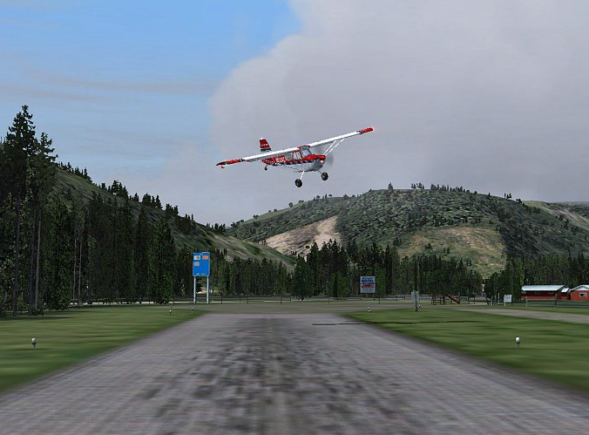
Side Slipping
Side slipping is a technique used in a glide descent to increase decent rate without increasing airspeed
A slide slip is where
Rudder and aileron are applied simultaneously in opposite directions (cross controlling)
Aircraft flies sideways in relation to airflow creating more drag
Pro spin configuration so control airspeed accurately using attitude

Slide 25
Airmanship
Lookout – all around and above before and during climb, all around and below before and during descend
Blindspots – lower nose every 500 feet in climb, check below with pax lookout before descent
Airspace - what type above and below and can we comply?
Altimeter – correct pressure set, usually the Manchester QNH
Cloud – ensure we remain clear as appropriate for airspace and altitude
Engine – monitor T’s and P’s

Slide 26
Exercise 8 Performance Climbing and Descending
Questions?

