Slide 1
Exercise 6
Straight and Level Flight
Phase 2
Aim - as syllabus
Copyright Marcus Furniss 2019

Slide 2
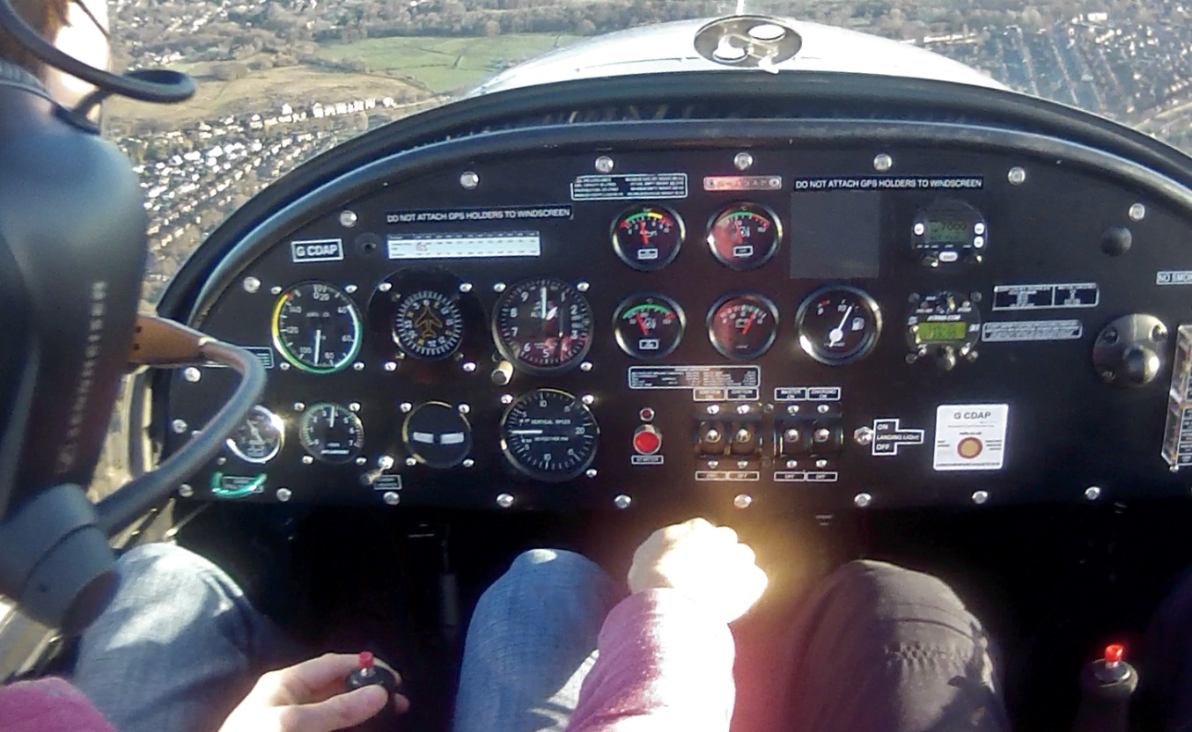
Straight and Level Flight
This is a core discipline used for general flying
Need for accuracy when circuit flying or through controlled airspace

Slide 3
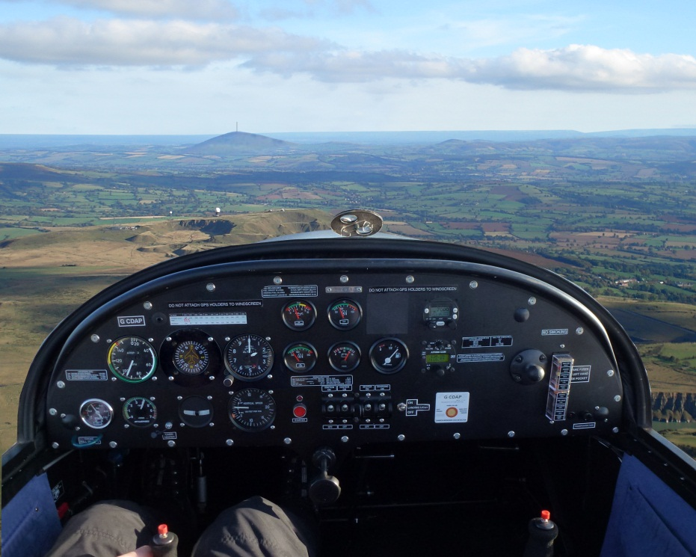
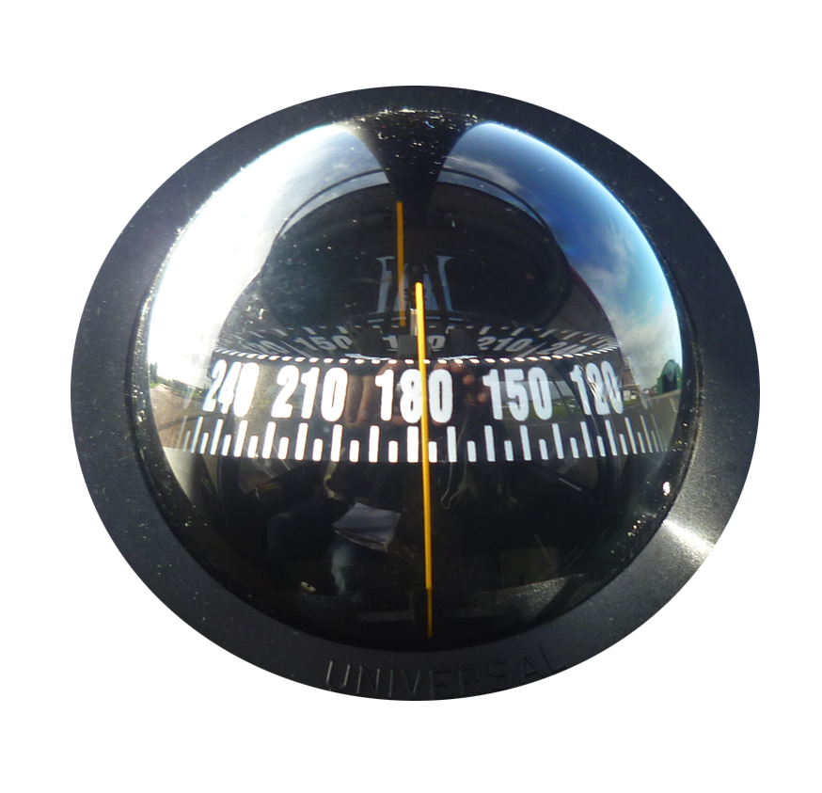

Straight Flight
Straight flight = wings level with horizon and in balance
Confirm straight by reference to either;
Visual Reference Point (VRP)
Compass

Slide 4
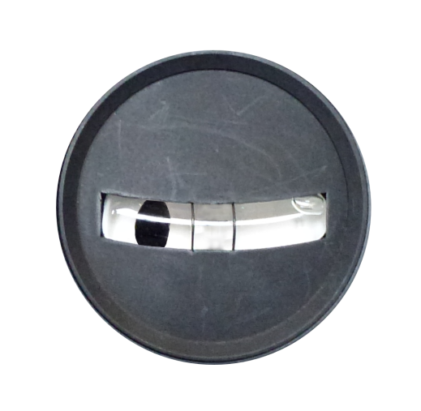
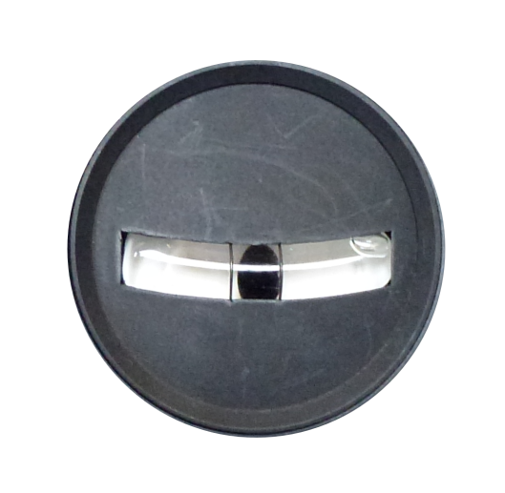
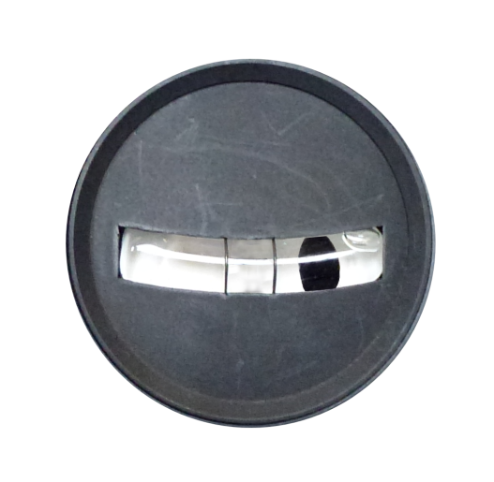
Straight Flight
Maintain wings level with horizon using small aileron inputs
  Reference aircraft structure to horizon
Maintain balance using rudder
  Remembering secondary effect and adjust aileron input as appropriate
Ball Left - Push Left rudder
Ball Right - Push Right rudder

Slide 5
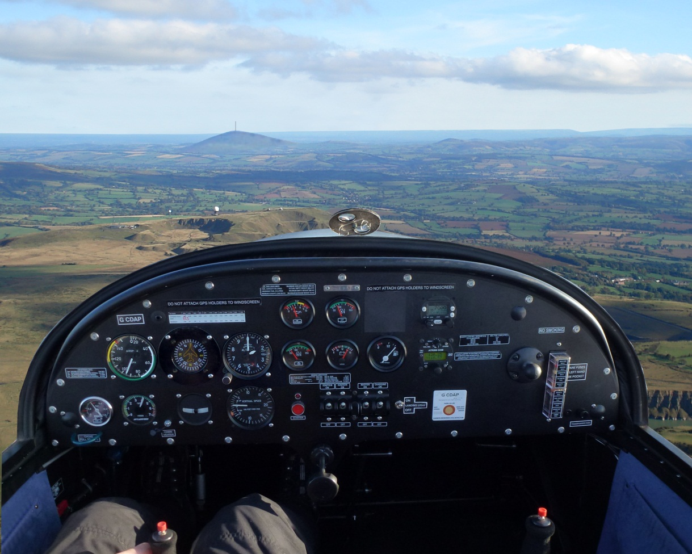
Heading Corrections
In EV97/C42 correct visual reference is ahead of you… NOT DIRECTLY AHEAD OF THE SPINNER

Slide 6
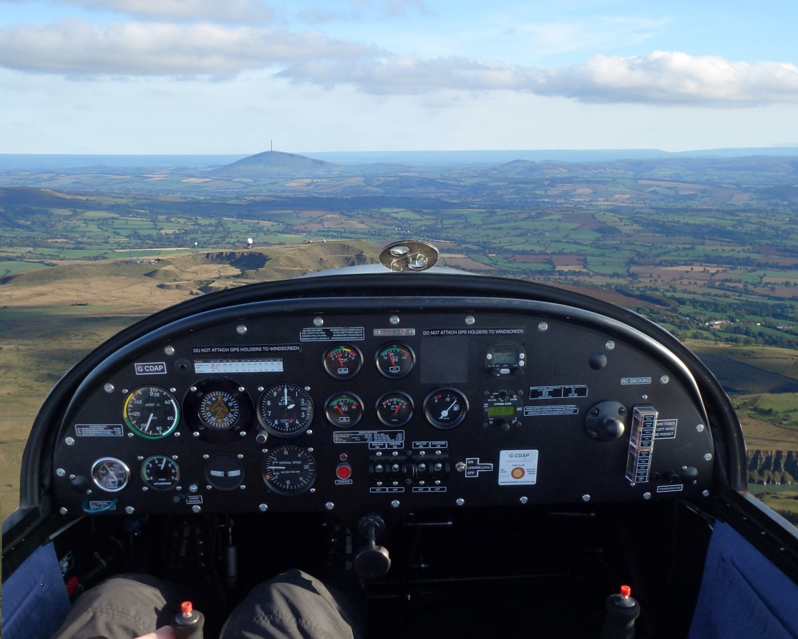
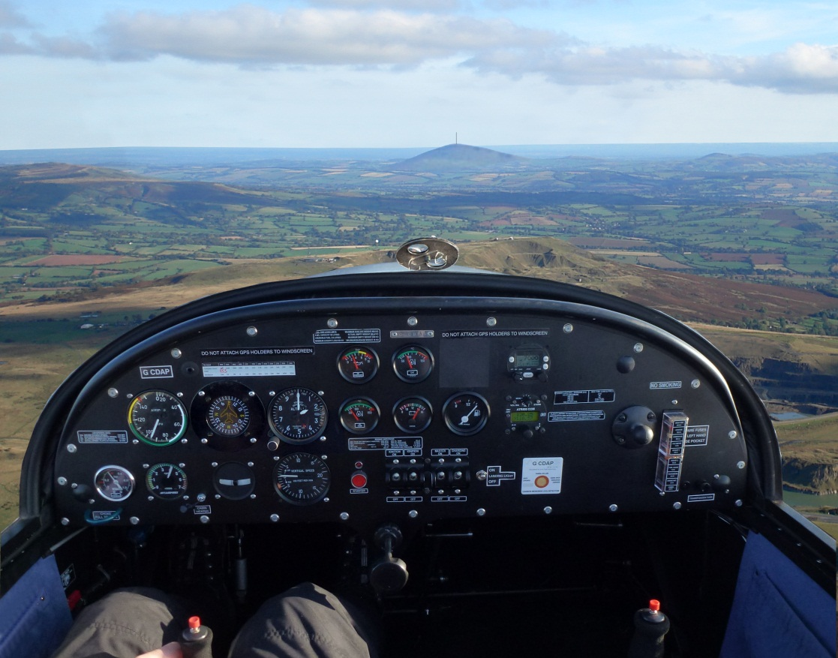
Heading Corrections
If aircraft is deviating from desired visual reference point;

Slide 7
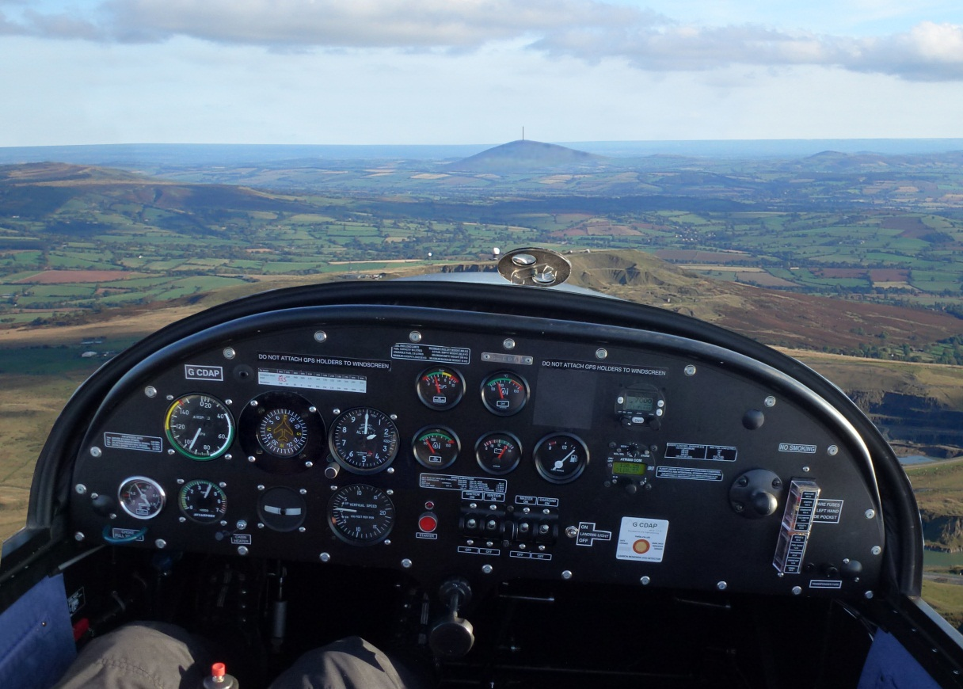
Heading Corrections
If aircraft is deviating from desired visual reference point;
  Gently bank towards it
  Coordinate aileron with rudder to prevent adverse yaw

Slide 8
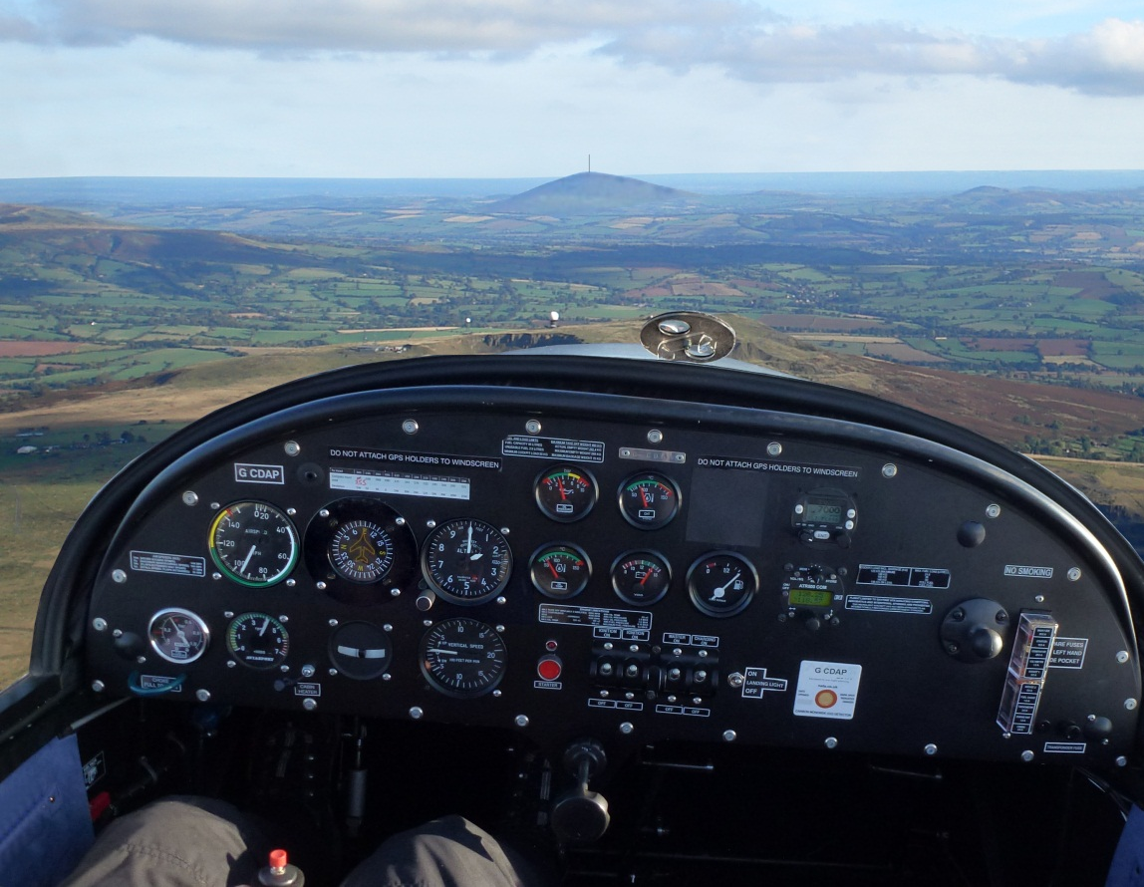
Heading Corrections
Slightly anticipate VRP
Roll wings level
Coordinate aileron with rudder to prevent adverse yaw

Slide 9

Drift – Caused by a Crosswind Component
B
B
B
Steady relative angle
WIND
Drift
WIND
WIND
Heading
Track
A
A
A
To fly straight towards a crosswind reference point, set up a drift angle so that the reference point remains at a steady relative bearing
Alternatively line up two distant reference points and adjust heading to keep aligned

Slide 10

To fly level at a steady trimmed airspeed
Correct pitch attitude and in trim (Hands off Trim)
Appropriate cruise RPM set
  C42 - 4400rpm/80kts
  EV97 – 4200rpm/90mph
  Remember exact power dependant on load carried – need to calibrate in flight
Steady altimeter
VSI reading zero
Height with power (throttle)
Basic Control Principles
  Airspeed with attitude (elevator)

Slide 11
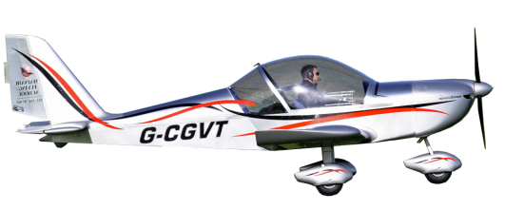
To fly level at a steady trimmed airspeed
Set required RPM
Adjust the attitude of the nose against the horizon to achieve cruise airspeed, trim, then check the VSI and ASI
If descending, check aircraft in trim + airspeed correct. If still descending;
  Increase power + prevent yaw with rudder (to stop descent)
  Raise nose, balance + trim (to prevent airspeed increasing)

Slide 12
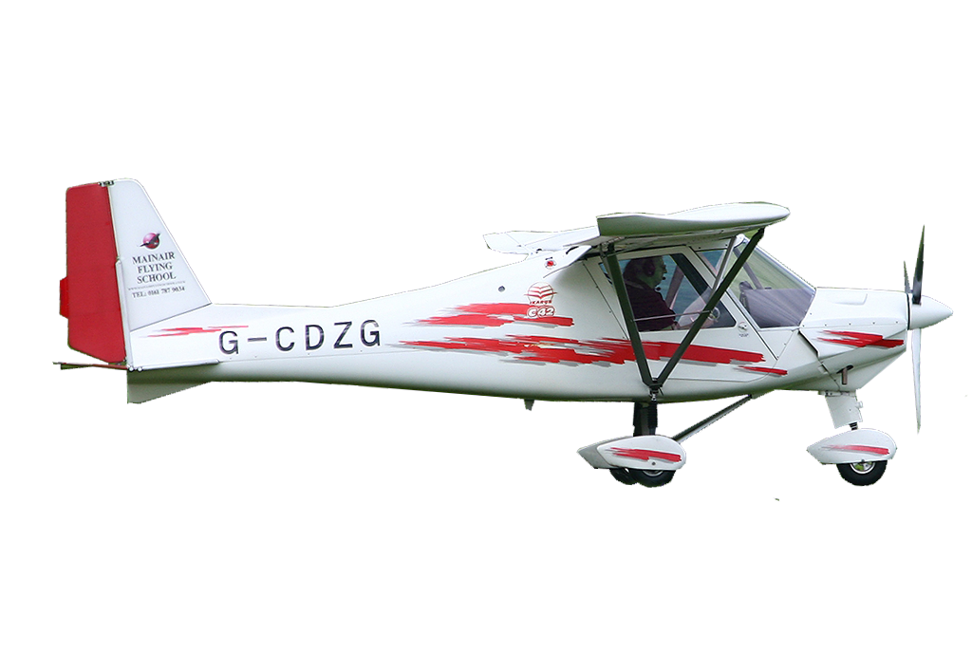
To fly level at a steady trimmed airspeed
If climbing, check aircraft in trim + airspeed correct. If still climbing;
  Lower nose, balance + trim (to prevent airspeed decreasing)
  Decrease power + prevent yaw with rudder (to stop climb)
  Power + Attitude = Performance

Slide 13
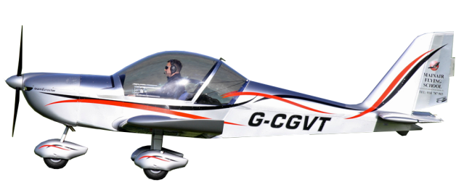
To fly level at a constant RPM
With some faster microlight types (C42 and Ev97) height can be maintained setting cruise RPM and by adjusting pitch attitude
Set cruise RPM then control height with attitude (pitch), referencing the Horizon, VSI and altimeter to determine level flight
If descending
  Raise nose slightly, hold new attitude + trim
  Ensure airspeed does not drop too close to the stalling speed!
If climbing
  Lower nose slightly, hold new attitude + trim

Slide 14

Level Flight at Specific Airspeeds
Power only
70
70
70
80
Power
Pitch
+
80
90
80
90
90
Pitch only
Power and pitch must be coordinated together to increase/decrease airspeed in level flight

Slide 15
Level Flight at Specific Airspeeds
P A T to increase airspeed in level flight
P – Power - increase
  Initial acceleration without climbing
A – Attitude – smoothly lower nose + hold to maintain level flight
  Reference VSI and Altimeter
T – Trim
  Balance to achieve level flight and trim to ‘Hands off Trim’
60 KTS
90 KTS

Slide 16
Level Flight at Specific Airspeeds
P A T to decrease airspeed in level flight
P – Power - decrease
  Initial deceleration without descending
A – Attitude – smoothly raise nose + hold to maintain level flight
  Reference VSI and Altimeter
T – Trim
  Balance to achieve level flight and trim to HOT
90 KTS
60 KTS

Slide 17
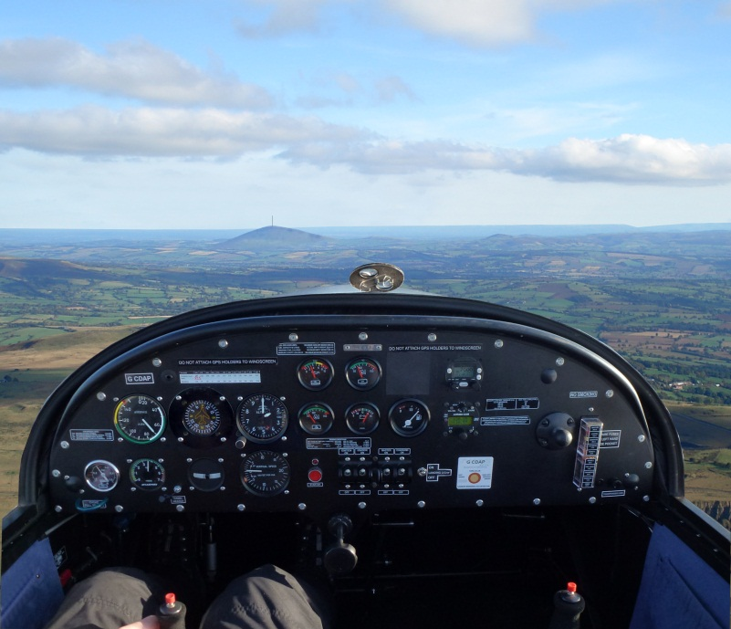
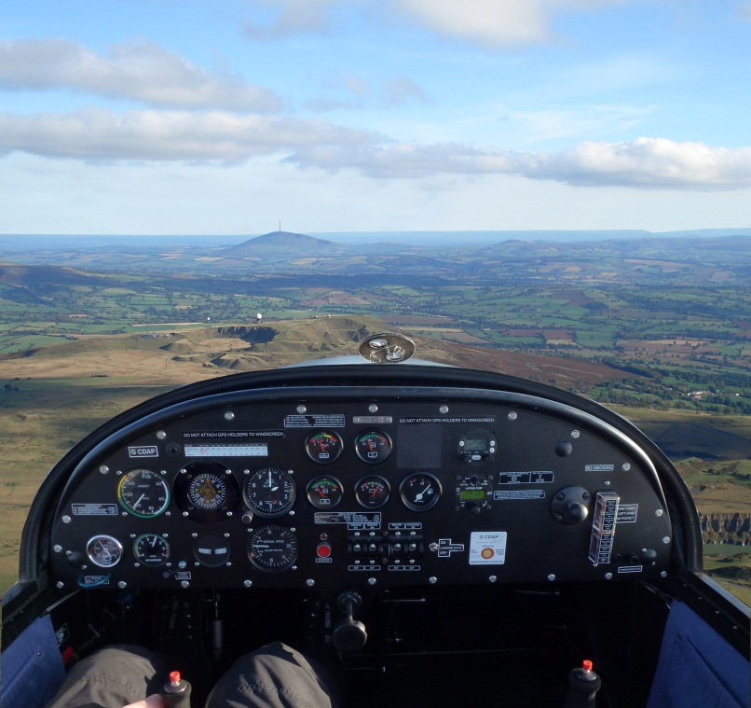
Level Flight at Specific Airspeeds
In steady level flight nose attitude will be:
  Higher for low airspeed
  Lower for high airspeed
70 Mph
100 Mph

Slide 18
Level Flight with Flaps
Flaps create same lift at lower speed
  Stall speed reduces
  Allows safer flight at slower airspeed (Slow Safe Cruise)
Flaps increase drag
  Nose attitude will be lower with flaps to maintain airspeed
Without Flaps
With Flaps
60 KTS
60 KTS
When using flaps airspeed must be in the white arc on the ASI

Slide 19
Straight and Level - Airmanship
Lookout
  Use the clock code to communicate position
  Vertical position should be expressed as high, level or low
12
9
3
6

Slide 20
Straight and Level - Airmanship
En route checks every 10-15 minutes
L
F
E
Location - where are we?
Instruments - are engine temperature and pressures (T’s +P’s) within limits?
Fuel – quantity, and how much already used?
Elapsed time - correlate with remaining fuel to calculate endurance
I

Slide 21
Exercise 6
Straight and Level Flight
Questions?

