Slide 1
Exercise 5
Taxiing
Phase 1
Aim - as syllabus
Copyright Marcus Furniss 2019

Slide 2
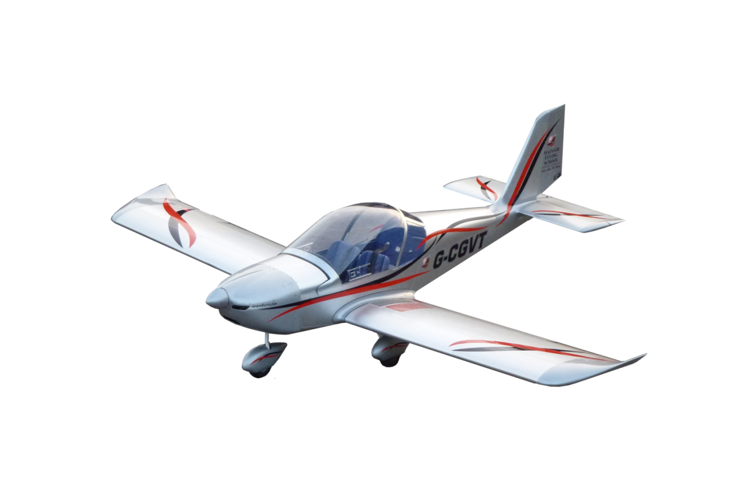
Starting and Stopping
Power is used to commence taxying
  Inertia - once taxying speed attained reduce power
A fast walking pace is a safe taxing speed
To slow down power should be reduced
  Don’t use power against brakes
Beware of the ground surface
  Loose stones/long grass
  Cross ridges at angle
Flaps should be retracted
  Wind/ low obstructions
Steer with rudder and differential brakes
  Anticipate movement
  Watch tail when turning sharply

Slide 3
Effects of Wind
Microlights are easily blown over in a wind. Correct use of controls can minimise possibility
Head wind - hold stick neutral or back to ease weight off nose wheel/hold the tail down on tail dragger
Tail wind - hold the stick neutral or forwards, this stops the wind from lifting the tail plane from behind
Cross wind - to prevent ‘weathercock,’ rudder and differential brakes may have to be used

Slide 4

Effects of Wind
To avoid a cross wind from ahead lifting the into wind wing: raise its aileron by moving the stick towards the wind
UP

Slide 5
Effects of Wind
To avoid a cross wind from ahead lifting the into wind wing: raise its aileron by moving the stick towards the wind
DOWN
UP
UP

Slide 6
Effects of Wind
To avoid a cross wind from behind lifting the into wind wing: lower its aileron by moving the stick out of wind
UP

Slide 7
Effects of Wind
To avoid a cross wind from behind lifting the into wind wing: lower its aileron by moving the stick out of wind
UP
DOWN
DOWN

Slide 8
Instrument Checks
When taxiing turn and check
  Compass moving in correct sense
  Slip ball moving
Also check T’s and P’s
Emergencies
Brake failure
  close throttle / steer away from obstructions / aim for high friction surface
Danger of collision
  close throttle / mags off / master off / fuel off

Slide 9
Airmanship
Good Look out before and during
Be aware of propeller wash
Operate throttle and brake smoothly
Obey right of way rules , ATC and marshalling instructions
Taxy at an appropriate speed – fast taxiing is
FOOLISH !

Slide 10
Exercise 5
Taxying
Questions?

