Slide 1
Exercise 4
Effects of Controls
Phase 1
Aim - as syllabus
Copyright Marcus Furniss 2019

Slide 2
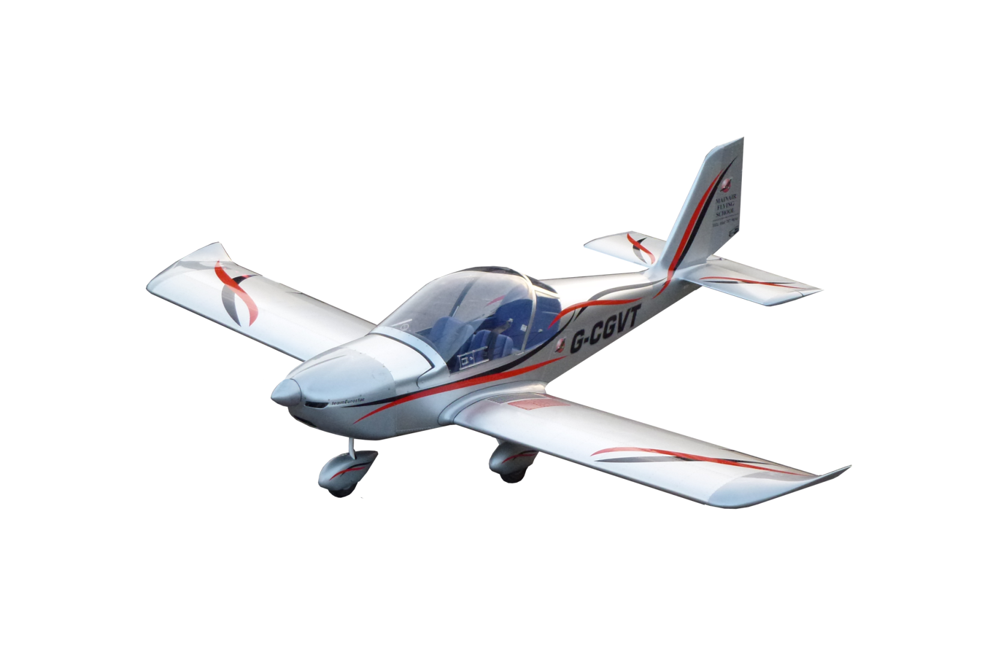

How the Aircraft Moves in Flight
The flight path of an aircraft can be resolved into three planes of movement;
  PITCH movement about the Lateral Axis
  ROLL movement about the Longitudinal Axis
  YAW movement about the Vertical Axis
Vertical Axis
Lateral Axis
Longitudinal Axis
Roll with Ailerons
Pitch with Elevator
Yaw with Rudder

Slide 3
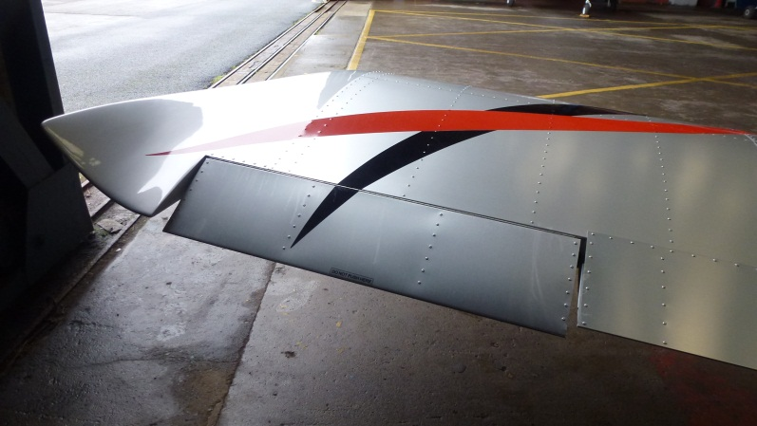
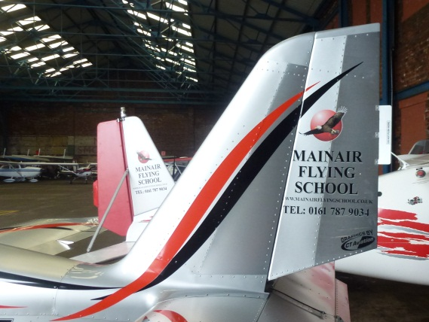
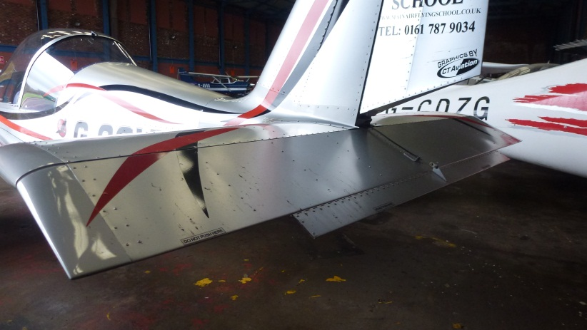
How the Aircraft Moves in Flight
Vertical Axis
Lateral Axis
Longitudinal Axis
Roll with Ailerons
Pitch with Elevator
Yaw with Rudder

Slide 4
How the Aircraft Moves in Flight
The pilot controls the motions around the three axes through the primary flight controls
The controls always operate relative to the aircraft’s three axes irrespective of its attitude in pitch or bank
Vertical Axis
Lateral Axis
Longitudinal Axis
Roll with Ailerons
Pitch with Elevator
Yaw with Rudder

Slide 5
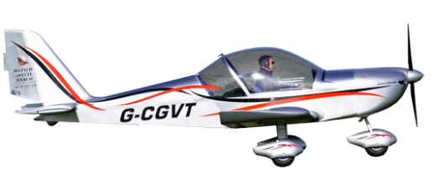
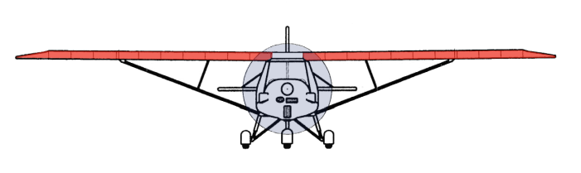
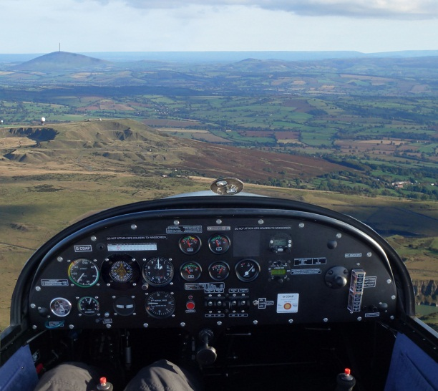
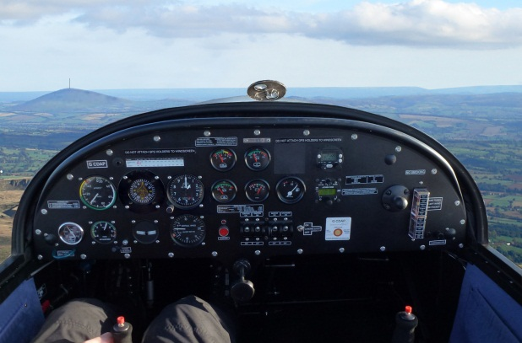
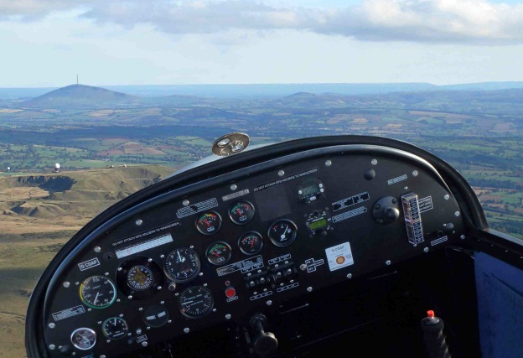
How Can we Tell This is Happening?
The Horizon is the PRIMARY REFERENCE
Nose High Attitude
Nose Low Attitude
Banked Attitude

Slide 6
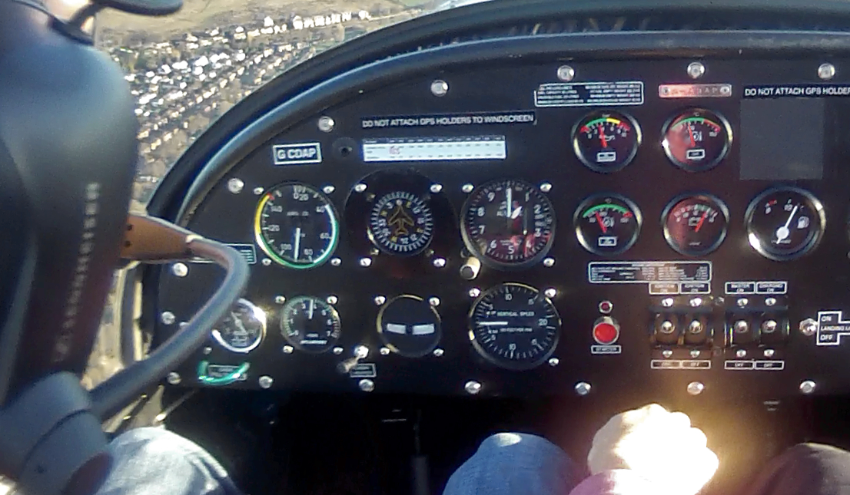
How Can we Tell This is Happening?
We can also see changes in;
  Altitude gauged by Altimeter and Vertical Speed Indicator (VSI)
  Airspeed gauged by Air Speed Indicator (ASI)
  Airspeed gauged by airflow in open cockpit aeroplane

Slide 7
Stability
If we are established in a steady state and in trim the aircraft will fly hands off (if there is no turbulence)
Hands Off Trim
Any movement away from this steady state in PITCH or YAW will result in a restoring force being generated which will be felt as pressure on the controls

Slide 8
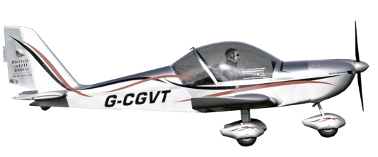
Primary Effects of Controls - Elevator
The Elevator controls Pitch
Moving the control column (Stick) backwards

Slide 9
Primary Effects of Controls - Elevator
The Elevator controls Pitch
Moving the control column (Stick) backwards
  Moves the Elevator UP
  Resulting force from deflected air causes nose to rise (PITCH UP)

Slide 10

Further Effects of Controls - Elevator
As the nose pitches up the Angle of Attack (AOA) of the wing in relation to the airflow will increase
This causes both Lift and Drag to increase
The increase in Lift will cause the aircraft to initially climb
The increase in Drag will cause the aircraft to decrease airspeed

Slide 11
Primary Effects of Controls - Elevator
Moving the control column (Stick) forwards

Slide 12

Primary Effects of Controls - Elevator
Moving the control column (Stick) forwards
  Moves the Elevator DOWN
  Resulting force from deflected air causes nose to lower (PITCH DOWN)

Slide 13
Futher Effects of Controls - Elevator
As the nose pitches down the Angle of Attack (AOA) of the wing in relation to the airflow will decrease
This causes both Lift and Drag to decrease
The decrease in Lift will cause the aircraft to descend
The decrease in Drag will cause the aircraft to increase airspeed

Slide 14
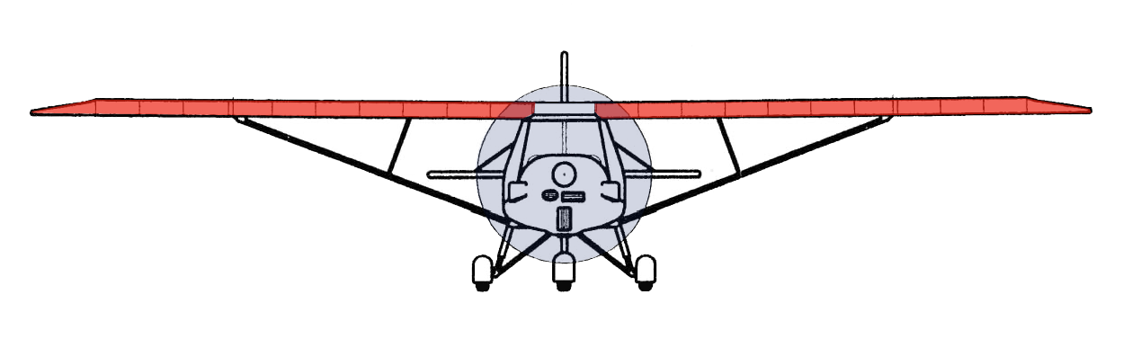
Primary Effects of Controls - Ailerons
Ailerons control Roll

Slide 15
Primary Effects of Controls – Ailerons
Ailerons control Roll
Moving the control column (Stick) to the left
  Moves the left Aileron UP and the right Aileron DOWN
  Resulting force from deflected air causes aircraft to roll to the left

Slide 16
Primary Effects of Controls – Ailerons
Ailerons control Roll
Moving the control column (Stick) to the left
  Moves the left Aileron UP and the right Aileron DOWN
  Resulting force from deflected air causes aircraft to roll to the left
  Roll will continue until stick is centralised

Slide 17
Primary Effects of Controls – Ailerons
Moving the control column (Stick) to the right

Slide 18
Primary Effects of Controls – Ailerons
Moving the control column (Stick) to the right
  Moves the left Aileron DOWN and the right Aileron UP
  Resulting force from deflected air causes aircraft to roll to the right

Slide 19
Primary Effects of Controls – Ailerons
Moving the control column (Stick) to the right
  Moves the left Aileron DOWN and the right Aileron UP
  Resulting force from deflected air causes aircraft to roll to the right
  Roll will continue until stick is centralised
  In roll most aircraft are neutrally stable

Slide 20

Further Effects of Ailerons
Roll causes Yaw
Once the aircraft is banked it will SLIP towards the lower wing due gravity
The change in airflow will cause the aircraft to YAW in the direction of the SLIP
This will cause aircraft to turn and lower the nose

Slide 21
Primary Effects of Controls – Rudder
The Rudder controls Yaw
Moving the left rudder pedal forwards

Slide 22
Primary Effects of Controls – Rudder
The Rudder controls Yaw
Moving the left rudder pedal forwards
  Moves the rudder to the left
  Resulting force from deflected air causes aircraft to Yaw to left

Slide 23
Primary Effects of Controls – Rudder
Moving the right rudder pedal forwards

Slide 24
Primary Effects of Controls – Rudder
Moving the right rudder pedal forwards
  Moves the rudder to the right
  Resulting force from deflected air causes aircraft to Yaw to right

Slide 25
Further Effects of Rudder
Yaw causes Roll
If the aircraft is Yawed by rudder due to inertia it will initially continue along its original flight path
Due to the dihedral effect the forward wing will then lift
The aircraft will Roll and the nose will slew below the horizon

Slide 26
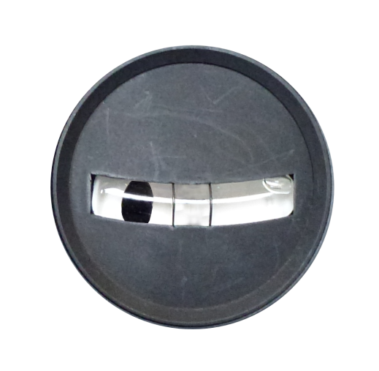
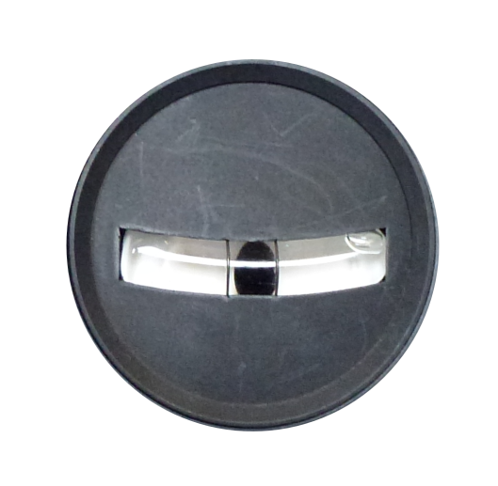
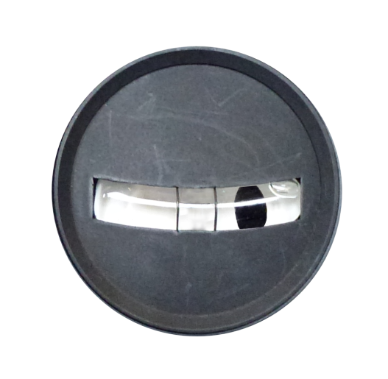
Balance Ball
Primary function of balance ball is to indicate unwanted Yaw
Ball in centre = aircraft in balance
Ball Left = Left Yaw
Push Left pedal to balance
NO YAW
Ball Right = Right Yaw
Push Right pedal to balance

Slide 27
Further Effects of Ailerons
Adverse Yaw
When rolling the aircraft the down going aileron causes more drag than the up going aileron
This increased drag will cause the aircraft to yaw in the opposite direction of the roll
This unwanted side effect is called Adverse Yaw and can be removed by coordinated rudder input

Slide 28
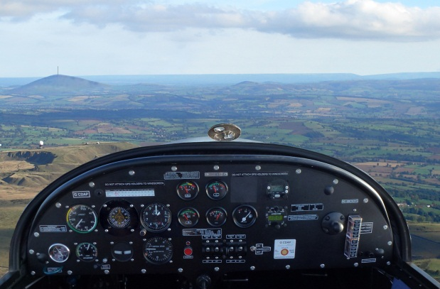
The Effects of Power
When power is increased
  The aircraft will accelerate temporarily
  The nose of the aircraft will rise to a new attitude and the aircraft will climb
  The airspeed will settle to a new value
80 MPH
90 MPH
100 MPH

Slide 29
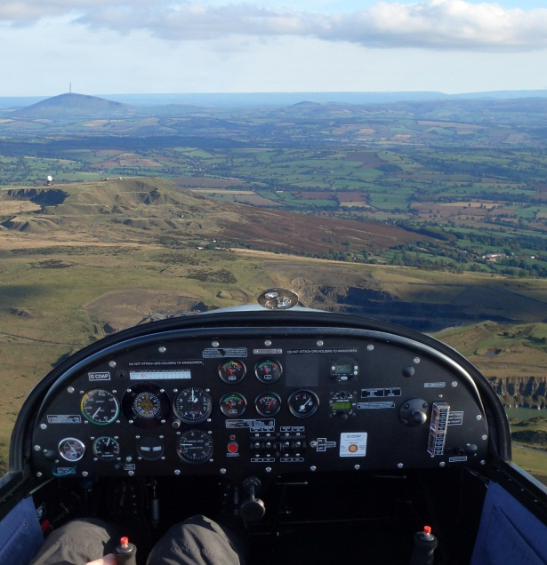
The Effects of Power
When power is decreased
  The aircraft will decelerate temporarily
  The nose of the aircraft will lower to a new attitude and the aircraft will descend
  The airspeed will settle to a new value
90 MPH
75 MPH
80 MPH

Slide 30
Summary
 | Control Input | Primary effect | Secondary effect
Pitch | Column Back | Nose pitches up Temporary increase in height | Airspeed decreases
 | Column Forward | Nose pitches down Decrease in height | Airspeed increases

Slide 31
Summary
 | Control Input | Primary effect | Secondary effect
Pitch | Column Back | Nose pitches up Temporary increase in height | Airspeed decreases
 | Column Forward | Nose pitches down Decrease in height | Airspeed increases
Roll | Column Right | Roll Right | Slip Right then Yaw Right
 | Column Left | Roll Left | Slip Left then Yaw Left

Slide 32
Summary
 | Control Input | Primary effect | Secondary effect
Pitch | Column Back | Nose pitches up Temporary increase in height | Airspeed decreases
 | Column Forward | Nose pitches down Decrease in height | Airspeed increases
Roll | Column Right | Roll Right | Slip Right then Yaw Right
 | Column Left | Roll Left | Slip Left then Yaw Left
Yaw | Right pedal Forward | Yaw Right | Roll Right
 | Left pedal Forward | Yaw Left | Roll Left

Slide 33
Summary
 | Control Input | Primary effect | Secondary effect
Pitch | Column Back | Nose pitches up Temporary increase in height | Airspeed decreases
 | Column Forward | Nose pitches down Decrease in height | Airspeed increases
Roll | Column Right | Roll Right | Slip Right then Yaw Right
 | Column Left | Roll Left | Slip Left then Yaw Left
Yaw | Right pedal Forward | Yaw Right | Roll Right
 | Left pedal Forward | Yaw Left | Roll Left
Power | Increase Power | Temporary increase airspeed | Nose pitches up Aircraft climbs Airspeed settles
 | Decrease Power | Temporary decrease airspeed | Nose pitches down Aircraft descends Airspeed settles

Slide 34
The Effect of Trim
Flying at speeds above or below the trimmed airspeed will require constant pressure on the control column due to the natural stability trying to return aircraft to trimmed airspeed
We should therefor trim for our desired airspeed;
  Select the desired attitude by use of the control column
  Adjust the trimmer until no pressure is needed on the control column
The Effect of Airspeed
High Airpseed = More effective controls, firmer, positive feel
Low Airpseed = Less effective controls, lighter, mushy feel

Slide 35
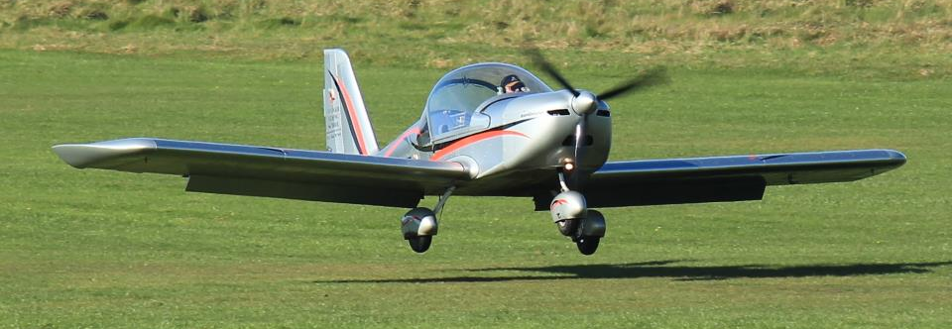
The Effect of Flaps
Flaps are attached to inboard trailing edge of wing
Operated mechanically on both Ev97 and C42
Work simultaneously to each other
Must be operated below Vfe (white arc) to avoid overstressing structure

Slide 36
The Effect of Flaps
When extended flaps change the shape of the wing
This increases LIFT and DRAG
Aircraft can now generate same lift at lower airspeed
Aircraft can now fly more slowly and stall speed is reduced

Slide 37
The Effect of Flaps
Small deflection = big increase in LIFT, small increase in DRAG
Larger deflection = small further increase in LIFT but big increase in DRAG
Flaps should be extended or retracted one stage at a time
Extending flaps will cause
  Aircraft to slow down and balloon
  Pitching tendency (nose up C42, nose down Ev-97)
Retracting flaps will cause
  Aircraft to accelerate and sink
  Pitching tendency (nose down C42, nose up Ev-97)

Slide 38
The Effect of Slipstream and Torque
Applying power produces a tendency to Yaw
  This is due corkscrew flow of air from propeller which in a EV-97 and C42 strikes the left side of the vertical fin and yaws the aircraft to the left.
  This effect is enhanced when with high power and slow airspeed ie on the take off roll or in the climb
Engine torque produces roll which can manifest as a tendency to roll when power setting is changed
Power setting can effect control effectiveness –
  At high power settings the effectiveness of the elevator and rudder is enhanced due to being in the accelerated airflow of the propeller slipstream

Slide 39
Airmanship
Lookout – we are responsible for our own collision avoidance. We must keep a constant lookout for other traffic and obstructions
  Scan - instructor to explain
  Blind spots
  Use the clock code to communicate position
  Vertical position should be expressed as high, level or low
12
9
3
6

Slide 40
Airmanship
Horizon is our primary reference – do not fixate on the instrument
Passing control – to avoid opposition of control input it is extremely important we are clear on passing control
“YOU HAVE CONTROL” “I HAVE CONTROL”
If I request control please relinquish immediately!

Slide 41
Exercise 4
Effects of Controls
Questions?

