Slide 1
Exercise 10a
Slow Flight
Phase 3
Aim - as syllabus
Copyright Marcus Furniss 2019

Slide 2
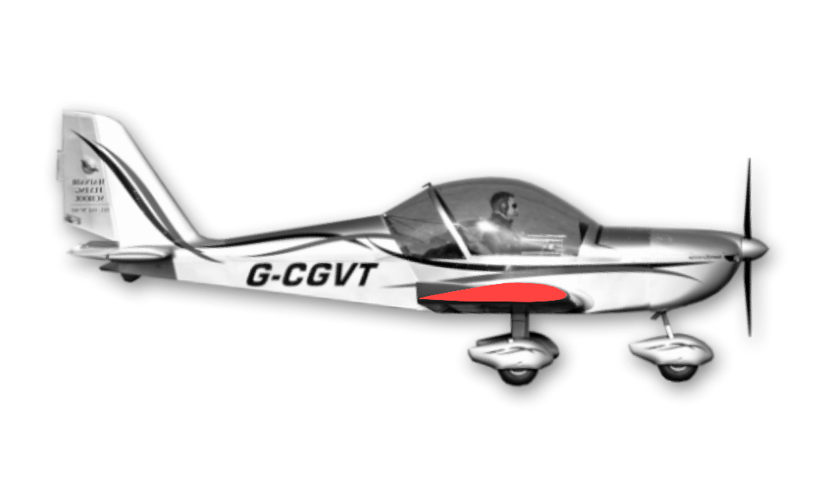
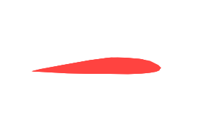

Theory – The Stall and Stalling Speed
In steady level flight as airspeed is reduced angle of attack (AOA) must be increased to increase lift
90mph

Slide 3
Theory – The Stall and Stalling Speed
AOA will increase whenever airspeed is reduced in steady state flight in level, climbing or gliding flight
60mph

Slide 4
Theory – The Stall and Stalling Speed
If flown too slowly the AOA will exceed the CRITICAL ANGLE and the airflow will break away from the top surface of the wing and STALL
Fully controlled flight is not possible below this critical angle and airspeed
44mph @ MTOW EV97, 41KTS C42

Slide 5
Indications of Slow Flight
Air Speed Indicator (ASI)
  The ASI has a lag and can also be subject to errors when flying through rain
Reduced Airflow
  This is a good indication in open cockpit aircraft with pusher prop (ie Flexwing)
Noise reduction due reduced airflow
Possible nose high attitude
  Become familiar with correct pitch attitude for different power and flap setting
Pitch control position and pressure
  Control column will be aft of normal position and there will be forwards pressure as aircraft tries to return to trimmed cruise speed

Slide 6
Indications of Slow Flight
Altered control response
  Pitch control will feel ‘nose heavy’
  Ailerons and rudder will be lighter and less effective (Mushy!)
  Note - Elevator and rudder will be more responsive at high power settings due increased propeller slipstream
Balance
  High power in slow flight tends to yaw EV-97 and C42 to left due finer pitch of slipstream so more right rudder is required to maintain balance
  Yaw could lead to possible lateral instability

Slide 7
Slow Flight in Turn
As the airspeed is reduced, radius of turn will reduce and rate of turn will increase
There will be an increased tendency to overbank
  This is due to the outer wing being at a higher airspeed (and therefore generating more lift) compared to inner wing
70mph
50mph

Slide 8
Slow Flight in Turn
Stalling speed will increase in a turn
  This is due increased loading in a turn (LF = L/W)
  Use low bank angles at low speed
  Maintain balance to avoid wing drop and possible spin entry
70mph
50mph

Slide 9
The Incipient Stall
This is where the airflow just starts to separate along the trailing edge
This is the last warning of the approach of the stall
approx46mph @ MTOW EV97, 43KTS C42

Slide 10
The Incipient Stall - Indications
Aerodynamic buffet
  Shaking felt through the stick and airframe caused by airflow starting to separate
Nose heaviness
  As the airflow separates the centre of pressure moves rearwards
Lateral instability
  More airflow separation on one wing than other

Slide 11
Recovery from Slow Flight and the Incipient Stall
The aim is to quickly accelerate the aircraft to a safe cruise speed
Simultaneously;
Move control column forwards to reduce AOA
Increase power – to aid acceleration with minimum height loss

Slide 12
Recovery from Slow Flight and the Incipient Stall
If wing drops do not attempt to pick it up with aileron
  Use opposite rudder to prevent further yaw whilst initiating recovery as above
Once aircraft is a safe margin above the stalling speed
  Nose can be raised to initiate a full powered shallow climb
  All controls can be used normally

Slide 13
The Effect of Flaps on
Slow Flight and Incipient Stall
Stalling speed is reduced with flaps extended
  Wing will now produce the same lift at lower airspeed and stalling speed will be reduced
  Aircraft will have a lower achievable airspeed ie it can fly more slowly
  However the incipient stall characteristics may be more pronounced
Nose attitude will be lower for a given power setting at the same airspeed
  If nose not lowered when flaps extended airspeed will reduce and slow flight may be inadvertently entered
44mph (41KTS C42)
36mph (32KTS C42)

Slide 14
Recovery from Slow Flight and Incipient Stall with Flaps extended
If the flaps are extended make initial recovery in the normal manner
Establish climb
  Remember nose attitude will be lower to maintain airspeed
Once positive rate of climb retract flaps one stage at a time
Whist drag flap will reduce rate of climb both EV-97 and C42 will climb with drag flaps set

Slide 15
Airmanship
H
Height – minimum 1000 AGL
Airframe - flaps set as applicable, limit speed noted
Security – straps loose articles
Engine – Temperatures and Pressure OK, fuel level
Location – Clear of Airspace, Built up areas, Cloud
Lookout – clearing turn to see all around, above, below
A
S
E
L
L

Slide 16
Exercise 10a
Slow Flight
Questions?

