Slide 1
Exercise 16a
Forced Landings
Phase 6
Aim - as syllabus
Copyright Marcus Furniss 2019

Slide 2
Why Would an Engine Fail?
Whilst unlikely, there are many potential causes for a power loss or engine failure;
Fuel Delivery
  Blockages, pump failure, fuel contamination or simply running out
Electrical
  We check the electrical system is working correctly before flight
Lubrication
  Always check we have sufficient oil before flight
Mechanical Failure
  Treat a rough running engine as an engine failure

Slide 3
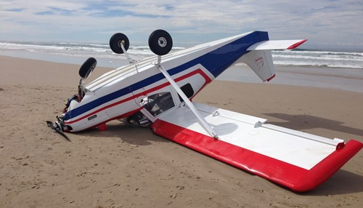
Forced Landings 16a
Whilst unlikely, aircraft should always be operated with the possibility of an engine failure
Consider potential landing options in relation to position and height
Avoid flight over large areas of unlandable terrain
Maintain required skills with regular practice
Failure to do so may result in…

Slide 4
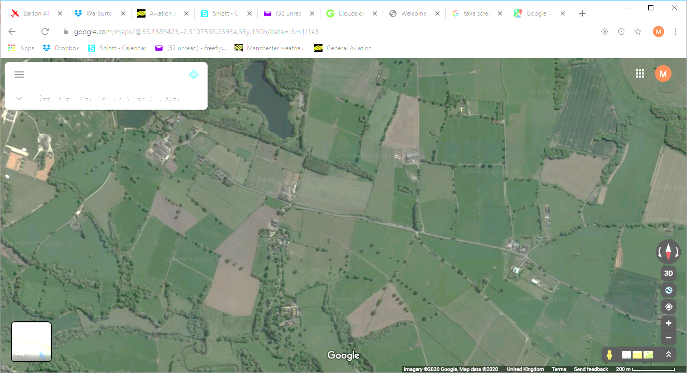

1
Fly The Aircraft
2000 AGL

Slide 5
Fly the Aircraft!
Adopt gliding attitude attain min sink and trim
  In general with low energy aircraft like microlights, immediately lower nose to obtain gliding attitude to avoid loss of airspeed and possible stall
Min Sink C42 = 45 KTS, EV-97 = 60 MPH
  In high performance types like C42 and EV-97 if airspeed is significantly higher than min sink speed then it may be beneficial to raise nose and convert speed to height

Slide 6
1
Fly The Aircraft
(min sink and trim)
2000 AGL

Slide 7
2
Estimate Wind
1
Fly The Aircraft
(min sink and trim)
1900 AGL

Slide 8
Estimate Wind Direction and Strength
We should always aim to land into wind
Smoke
Surface indications
  Wind patterns in standing crop
  Ripples on water – reflective, non-rippled areas are at upwind end
Drift
  Airspeed v Ground speed / Heading v Track
Known local wind
  Make a note when carrying out pre flight checks
Cloud shadow
  Allow for surface wind to back approx 30 degrees v wind at altitude

Slide 9
2
Estimate Wind
1
Fly The Aircraft
(min sink and trim)
1900 AGL

Slide 10
Wind
2
Estimate Wind
1
Fly The Aircraft
(min sink and trim)
1900 AGL

Slide 11
Wind
3
Select Landing Area
2
Estimate Wind
1
Fly The Aircraft
(min sink and trim)
1800 AGL

Slide 12
Select Landing Area
Gliding range
  Select a landing area close enough to glide to and with enough height to fly safe procedure
  Range will depend on wind
  Initially look left and low, then all around (C42/Ev-97)
  If no suitable areas can be seen, turn downwind
Size
  Big is better but should be at least long enough to allow for minor errors of judgement, sink, lift etc
Shape
  Shape should allow sufficient length to land into wind
  Check that intended landing area is clear of power cables and fences
  Remember posts are easier to spot than the wires themselves

Slide 13
Select Landing Area
Surface
  As smooth and firm as possible, ideally short grass or cut crop
  If tractor lines, try to land in their direction
  Ploughed fields or standing crop not ideal
  ‘Green is good, brown is bad, light brown…could be OK’
Shoots
  Over and undershoots – ideally pick a landing area that allows for errors in judgement or unexpected sink
Civilization
  If landing options are all poor and there is a high chance of damage, than consider those closer to habitation/roads as this will enable you to more easily get outside assistance should it be required

Slide 14
Wind
3
Select Landing Area
2
Estimate Wind
1
Fly The Aircraft
(min sink and trim)
1800 AGL

Slide 15
Wind
4
Fly the Plan
3
Select Landing Area
2
Estimate Wind
1
Fly The Aircraft
(min sink and trim)
1700 AGL

Slide 16
Constant Aspect Method
Wind
High Key Point
Approx 1000’ AGL
Best Glide
Flaps as required
Constant angle
4
Fly the Plan
INITIAL AIM 1/2
FINAL AIM 1/3
Select Landing Area
3
Low Key Point
Wings level
2
Estimate Wind
Approx 300’ AGL
1
Fly The Aircraft
(min sink and trim)
Approx 500’ AGL
Flaps as required
1700 AGL

Slide 17
Constant Aspect Method
Wind
High Key Point
Approx 1000’ AGL
Best Glide
Flaps as required
Constant angle
4
Fly the Plan
INITIAL AIM 1/2
FINAL AIM 1/3
Select Landing Area
3
Low Key Point
Wings level
2
Estimate Wind
Approx 300’ AGL
IF TOO LOW
IF TOO HIGH
Sideslip / S-turns
1
Fly The Aircraft
(min sink and trim)
Approx 500’ AGL
Flaps as required
1700 AGL

Slide 18
Constant Aspect Method
Wind
High Key Point
Approx 1000’ AGL
Best Glide
Flaps as required
Constant angle
4
Fly the Plan
INITIAL AIM 1/2
FINAL AIM 1/3
Select Landing Area
3
Low Key Point
Wings level
2
Estimate Wind
Approx 300’ AGL
IF TOO LOW
IF TOO HIGH
Sideslip / S-turns
1
Fly The Aircraft
(min sink and trim)
Approx 500’ AGL
Flaps as required
1700 AGL

Slide 19
Constant Aspect Method
Wind
High Key Point
Approx 1000’ AGL
5
Mayday Call
Best Glide
Flaps as required
Constant angle
4
Fly the Plan
INITIAL AIM 1/2
FINAL AIM 1/3
Select Landing Area
3
Low Key Point
Wings level
2
Estimate Wind
Approx 300’ AGL
IF TOO LOW
IF TOO HIGH
Sideslip / S-turns
1
Fly The Aircraft
(min sink and trim)
Approx 500’ AGL
Flaps as required
1600 AGL

Slide 20
Fly The Plan
5. Mayday Call
  Frequency in use or 121.5, transponder to 7700…but only if this doesn’t distract from the flying

Slide 21
Constant Aspect Method
Wind
High Key Point
Approx 1000’ AGL
5
Mayday Call
Best Glide
Flaps as required
Constant angle
4
Fly the Plan
INITIAL AIM 1/2
FINAL AIM 1/3
Select Landing Area
3
Low Key Point
Wings level
2
Estimate Wind
Approx 300’ AGL
IF TOO LOW
IF TOO HIGH
Sideslip / S-turns
1
Fly The Aircraft
(min sink and trim)
Approx 500’ AGL
Flaps as required
1600 AGL

Slide 22
Constant Aspect Method
Wind
6
Attempt Restart
High Key Point
Approx 1000’ AGL
5
Mayday Call
Best Glide
Flaps as required
Constant angle
4
Fly the Plan
INITIAL AIM 1/2
FINAL AIM 1/3
Select Landing Area
3
Low Key Point
Wings level
2
Estimate Wind
Approx 300’ AGL
IF TOO LOW
IF TOO HIGH
Sideslip / S-turns
1
Fly The Aircraft
(min sink and trim)
Approx 500’ AGL
Flaps as required
1500 AGL

Slide 23
Fly The Plan
5. Mayday Call
  Frequency in use or 121.5, transponder to 7700…but only if this doesn’t distract from the flying
6. Attempted restart
  Check ignition on, fuel on, Carb heat if appropriate

Slide 24
Constant Aspect Method
Wind
6
Attempt Restart
High Key Point
Approx 1000’ AGL
5
Mayday Call
Best Glide
Flaps as required
Constant angle
4
Fly the Plan
INITIAL AIM 1/2
FINAL AIM 1/3
Select Landing Area
3
Low Key Point
Wings level
2
Estimate Wind
Approx 300’ AGL
IF TOO LOW
IF TOO HIGH
Sideslip / S-turns
1
Fly The Aircraft
(min sink and trim)
Approx 500’ AGL
Flaps as required
1500 AGL

Slide 25
Constant Aspect Method
7
T.I.F.S Check
Wind
6
Attempt Restart
High Key Point
Approx 1000’ AGL
5
Mayday Call
Best Glide
Flaps as required
Constant angle
4
Fly the Plan
INITIAL AIM 1/2
FINAL AIM 1/3
Select Landing Area
3
Low Key Point
Wings level
2
Estimate Wind
Approx 300’ AGL
IF TOO LOW
IF TOO HIGH
Sideslip / S-turns
1
Fly The Aircraft
(min sink and trim)
Approx 500’ AGL
Flaps as required
1400 AGL

Slide 26
Fly The Plan
5. Mayday Call
  Frequency in use or 121.5, transponder to 7700…but only if this doesn’t distract from the flying
6. Attempted restart
  Check ignition on, fuel on, carb heat if appropriate
7. T.I.F.S check
  Throttle closed
  Ignition off, Master off when RT complete
  Fuel off
  Security – check harness tight, reassure passenger

Slide 27
Constant Aspect Method
7
T.I.F.S Check
Wind
6
Attempt Restart
High Key Point
Approx 1000’ AGL
5
Mayday Call
Best Glide
Flaps as required
Constant angle
4
Fly the Plan
INITIAL AIM 1/2
FINAL AIM 1/3
Select Landing Area
3
Low Key Point
Wings level
2
Estimate Wind
Approx 300’ AGL
IF TOO LOW
IF TOO HIGH
Sideslip / S-turns
1
Fly The Aircraft
(min sink and trim)
Approx 500’ AGL
Flaps as required
1400 AGL

Slide 28
Constant Aspect Method
7
T.I.F.S Check
Wind
6
Attempt Restart
High Key Point
Approx 1000’ AGL
5
Mayday Call
Best Glide
Flaps as required
Constant angle
4
Fly the Plan
INITIAL AIM 1/2
FINAL AIM 1/3
Select Landing Area
3
Low Key Point
Wings level
2
Estimate Wind
Approx 300’ AGL
IF TOO LOW
IF TOO HIGH
Sideslip / S-turns
1
Fly The Aircraft
(min sink and trim)
Approx 500’ AGL
Flaps as required
100 AGL

Slide 29
Keep in balance during turns and monitor safe A/S
Try to limit turns to 30 deg bank angle
Flaps as appropriate
Beats and Turns Method
If too low for circuit method
INITIAL AIM 1/2
FINAL AIM 1/3
Wind
Wings level
Full Flaps /Sideslip
T.I.F.S Check
Position aircraft on Beat line/Base leg
4
Fly the Plan
7
Best Glide
1st Stage flaps
Attempt Restart
Select Landing Area
6
3
5
Mayday Call
2
Asses Wind
REFERENCE LINE OR POINT
To prevent aircraft migration towards field
1
Fly The Aircraft
1200 AGL

Slide 30
Landing
Touchdown
  Surface unknown, so land as softly as possible and fully held off to minimise touchdown speed
  If landing on crop treat top of crop as landing surface
After landing
  Secure aircraft – check position and livestock
  Cancel mayday – by radio or phone
  Notify destination within 30 mins of your planned arrival time
  Notify land owner
  Consider very carefully take off and only if absolutely sure cause identified and rectified

Slide 31
Airmanship for Practice Engine Failure
Lookout
Be mindful of the 500’ rule
Choose multiple sites to practice – don’t be a nuisance
Consider the descent and climb out path
  Always be ready for real engine failure
  Ensure decent and climb out are free from obstructions
Warm engine in the descent
  Helps prevent carburettor icing
  When going around increase power gradually and raise nose, then retract flaps in stages
Manage airspeed in go around – respect Vfe

Slide 32
Exercise 16a
Forced Landings
Questions?

Slide 33
Constant Aspect Method
7
T.I.F.S Check
6
Attempt Restart
High Key Point
Approx 1000’ AGL
5
Mayday Call
Best Glide
Flaps as required
Constant angle
4
Fly the Plan
INITIAL AIM 1/2
(best glide 58Kts and trim)
FINAL AIM 1/3
Select Landing Area
3
Low Key Point
Approx 300’ AGL
Wings level
2
Asses Wind
IF TOO LOW
1
Fly The Aircraft
Approx 500’ AGL
IF TOO HIGH
Sideslip / S-turns
(min sink 45 Kts and trim)
2000 AGL

Slide 34
Keep in balance during turns and monitor safe A/S
Try to limit turns to 30 deg bank angle
Flaps as appropriate
Beats and Turns Method
If too low for circuit method
INITIAL AIM 1/2
FINAL AIM 1/3
Wings level
Full Flaps /Sideslip
Position aircraft on base leg
4
Fly the Plan
Best Glide
1st Stage flaps
3
Select Landing Area
2
Asses Wind
REFERENCE LINE OR POINT
To prevent aircraft migration towards field
1
Fly The Aircraft
1000 AGL

