Slide 1
Exercise 15 Recognition of Unusual Attitudes; Prevention of Dangerous Conditions
Phase 5
Aim - as syllabus
Copyright Marcus Furniss 2019

Slide 2
Unusual Attitudes
Unusual attitudes are combinations of
Pitch
Bank
Yaw
Power setting
These are at the extremes of, but still inside the flight envelope
Our aim is to recognise and recover safely from these unusual attitudes before they become dangerous

Slide 3
Aircraft Limitations
All aircraft have LIMITS in terms of attitudes, airspeeds and loadings
Velocity never exceed speed (Vne)
Marked with red line on ASI
C42 121 kts, Ev-97 146 mph
Exceeding speed may lead to controllability problems / aerodynamic flutter / possible structural failure
Manoeuvring speed (Va)
C42 82 KT, Ev-97 100 mph
Airspeed beyond which ‘Large or Abrupt’ control inputs may exceed the limit load factors and cause structural damage
Be increasing gentle with control inputs above this speed

Slide 4
Aircraft Limitations
Max rough air speed (Vno)
Marked by top of green arc on ASI
C42 not quoted, EV-97 118 mph
Max airspeed recommended in rough air to avoid overstressing the airframe. In some aircraft Vno is not specified so Va should be used
Flap limiting speed (Vfe)
Marked by top of white arc on ASI
C42 63 KT, Ev-97 77mph
Maximum speed for flap deployment and use – above this can result in flap or rear spar damage
Maximum bank angle 60 degrees
Most microlights use the generic limit of 60 deg. Beyond this is considered aerobatic and speeds and loadings can rapidly increase

Slide 5
Aircraft Limitations
Maximum pitch angle 45 degrees
Check flight manual - beyond this is considered aerobatic
Steep nose up can lead to very steep stalls with significant height loss
Steep nose down can lead to quickly exceeding Vne
Maximum G loadings +4g and -2g (LF=L/W)
These are standard values for most microlights - exceeding these load limits can result in catastrophic structural failure
Manoeuvres at these limits may be considered as unusual attitudes, but if left uncorrected may develop further and become dangerous

Slide 6
Why Would This Happen?
Encountering severe meteorological conditions
Turbulence from mountain terrain, wave rotor, thunderstorms etc
Severe wake turbulence
Inadvertently crossing the wake of aircraft or helicopter
Loss of control in cloud
Microlight aircraft should be flown VFR only however pilots that have been caught out and have to descend through cloud become disorientated and loss of control has quickly resulted
Mishandling the controls during stall recovery or steep turns
Deliberately attempting manoeuvres out of the aircraft limits
Microlight aircraft are not designed for aerobatics

Slide 7
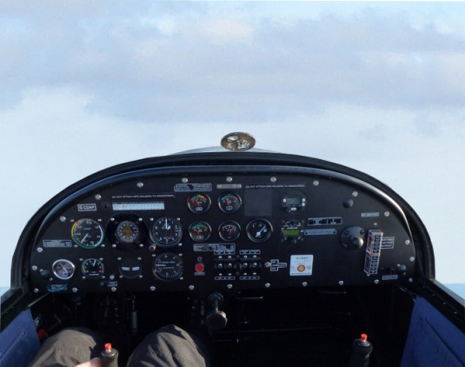
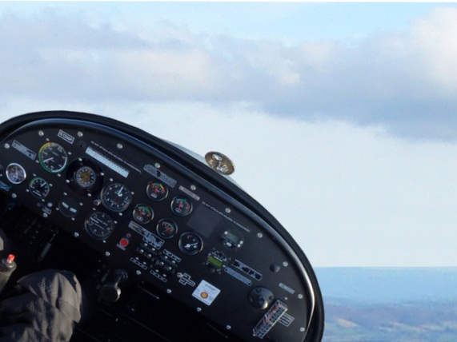
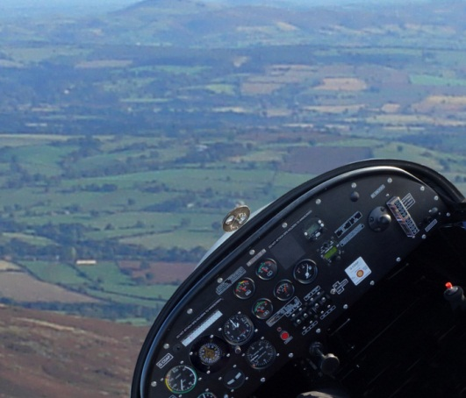
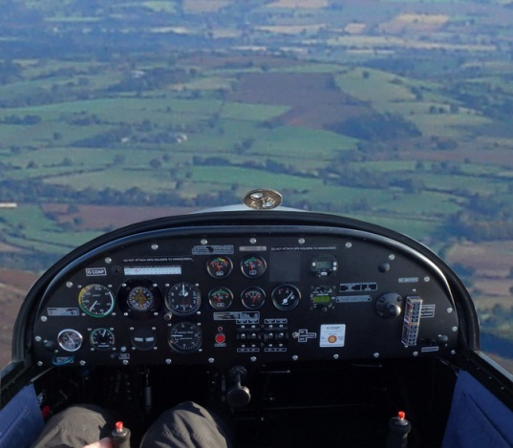
4. Nose High and Banked
2. Nose High
The Four Basic Unusual Attitudes
3. Nose Low and Banked
1. Nose Low

Slide 8
1. Nose Low
Airspeed will be rising – the danger is that Vne can be exceeded
RECOVERY
Close throttle, if airspeed becoming high (This will reduce acceleration rate)
Retract flaps if extended to avoid exceeding Vfe
Ease out of dive and adopt shallow climbing attitude
Once airspeed is safe apply full power and adopt climb

Slide 9
2. Nose High
Airspeed will be reducing - the danger is that a steep stall will be rapidly approaching
RECOVERY
Simultaneously
Apply power – this will reduce rate of speed decay. Prevent yaw with rudder
Lower the nose to level attitude
(If done correctly this will result in less than 1G and has benefit of reducing stall speed)
Once airspeed is safe apply full power and adopt shallow climb

Slide 10
3. Nose Low and Banked
Airspeed will be rising – the danger is that Vne can be exceeded
RECOVERY
Close throttle, if airspeed becoming high (This will reduce acceleration rate)
Retract flaps if extended to avoid exceeding Vfe
Roll wings level with coordinated aileron and rudder
Ease out of dive and adopt shallow climbing attitude
Once airspeed is safe apply full power and adopt climb

Slide 11
4. Nose High and Banked
Airspeed will be reducing – the danger is that aircraft can stall and possibly spin
RECOVERY
Simultaneously
Apply power – this will reduce rate of speed decay. Prevent yaw with rudder
Lower the nose to level attitude
(If done correctly this will result in less than 1G and has benefit of reducing stall speed)
Roll wings level with coordinated aileron and rudder
Once airspeed is safe apply full power and adopt shallow climb

Slide 12
Assess the Attitude
If the horizon cannot be assessed initially due disorientation or loss of visible horizon
DO NOTHING!
Keep the controls in the neutral position until attitude is established and appropriate recovery actions can be applied

Slide 13
Airmanship
H
Height – minimum 1000 AGL
Airframe - flaps set as applicable, limit speed noted
Security – straps loose articles
Engine – Temperatures and Pressure OK, fuel level
Location – Clear of Airspace, Built up areas, Cloud
Lookout – clearing turn to see all around, above, below
A
S
E
L
L

Slide 14
Airmanship
Lookout
In addition to the regular HASELL checks keep a good lookout during each individual manoeuvre
Limits
Know the limits for your aircraft and do not exceed them in practice
NO SOLO STUDENT PRACTICE
The exercise must only be practiced with an instructor
Physiological effects
We will experience both increased and decreased G forces. We practice so that in an emergency situation such forces will not cause distraction

Slide 15
Exercise 15 Recognition of Unusual Attitudes; Prevention of Dangerous Conditions
Questions?

