Slide 1
Exercise 12
Circuit Training
Phase 4
Aim - as syllabus
Copyright Marcus Furniss 2019

Slide 2
2015 – Amendment to following presentation;
Due to movement in magnetic variation
Runway 27 is now 26
Runway 09 is now 08

Slide 3
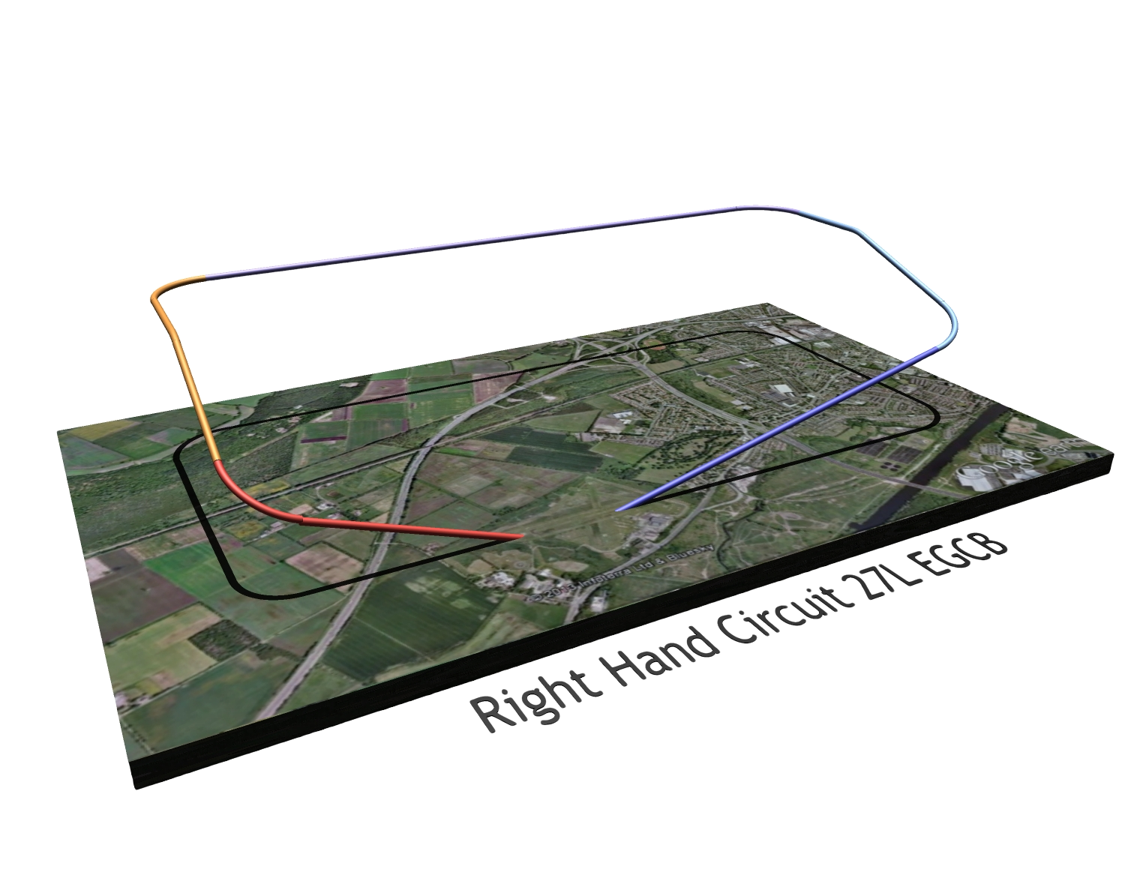
The Circuit
What is the purpose of The Circuit?

Slide 4
The Circuit
The circuit is a standard path for coordinating air traffic around an airfield, as safely as possible
By using a consistent flight pattern pilots will know from where to expect other air traffic, and be able to see it and avoid it

Slide 5
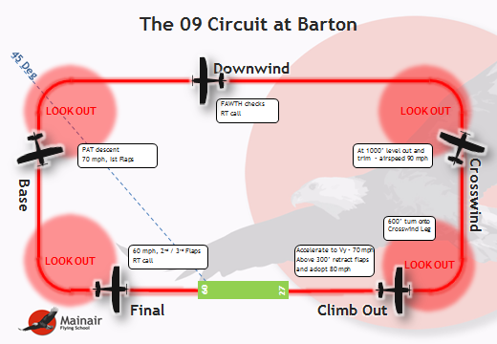
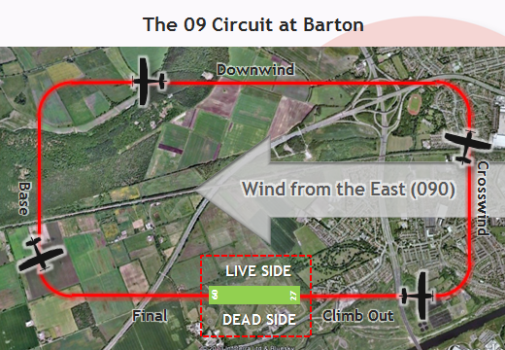
The Circuit
Over several sessions we will learn
  Circuit procedures
  To fly the circuit accurately and safely
  Different take off and landing techniques
  To deal with circuit emergencies
Plenty of practice is required to build up skills!

Slide 6
The Standard Into Wind Take Off
Before Take Off
  Pre take off checks - VITAL ACTIONS
  Flap setting for conditions and surface
  Look out before entering runway
  If ATC obtain permission before entering runway
  On lining up check correct runway using compass

Slide 7
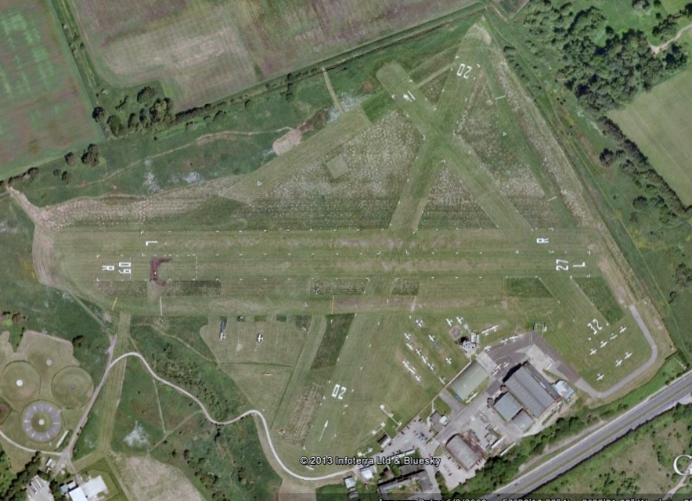
The Runways at Barton
6 runway directions
  26/08
  02/20
  32/14
We land and take off into wind to
  Reduce take off ground speed and distance
  Reduce landing ground speed and distance

Slide 8
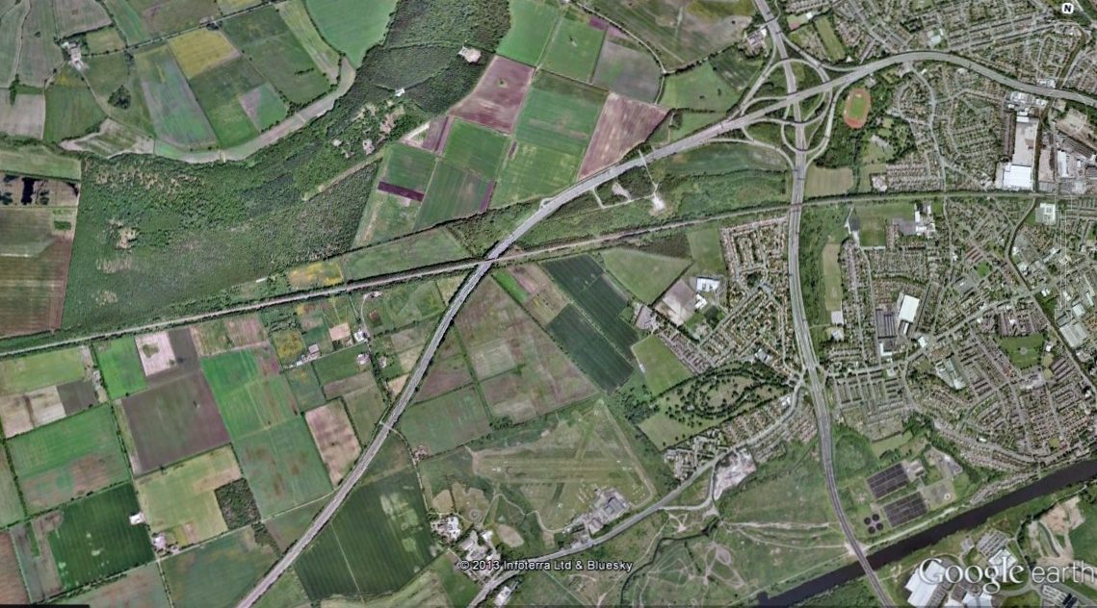

The 26 Circuit at Barton
Downwind
Wind from the West (260)
Crosswind
Base
LIVE SIDE
08
26
Climb Out
DEAD SIDE
Final

Slide 9
The 26 Circuit at Barton
Downwind
45 Deg
LOOK OUT
Check parallel to runway
Check to Dead side for joining traffic
FAWTH checks
RT call
LOOK OUT
At 1000’ level out and trim - airspeed 90 mph
PAT descent
70 mph, Ist Flaps
Crosswind
Base
600’ turn onto Crosswind Leg
LOOK OUT
Accelerate to Vy - 70 mph
Above 300’ AGL retract flaps and adopt 80 mph
60 mph, 2nd / 3rd Flaps
RT call
LOOK OUT
09
27
Climb Out
Final

Slide 10
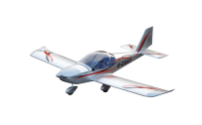
The 26 Circuit at Barton
Wind from West

Slide 11
The 08 Circuit at Barton
Downwind
Wind from the East (080)
Base
Crosswind
LIVE SIDE
08
26
Final
Climb Out
DEAD SIDE

Slide 12
The 08 Circuit at Barton
45 Deg
Downwind
LOOK OUT
FAWTH checks
RT call
Check parallel to runway
Check to Dead side for joining traffic
LOOK OUT
PAT descent
70 mph, Ist Flaps
At 1000’ level out and trim - airspeed 90 mph
Base
Crosswind
600’ turn onto Crosswind Leg
LOOK OUT
60 mph, 2nd / 3rd Flaps
RT call
Accelerate to Vy - 70 mph
Above 300’ AGL retract flaps and adopt 80 mph
LOOK OUT
09
27
Final
Climb Out

Slide 13
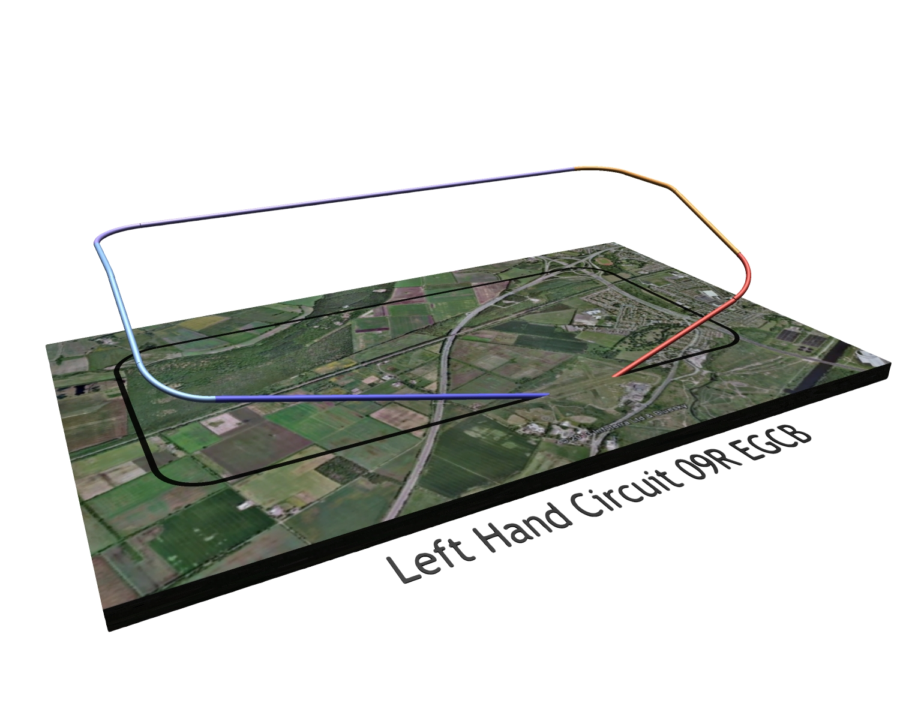

The 08 Circuit at Barton
Wind from East

Slide 14
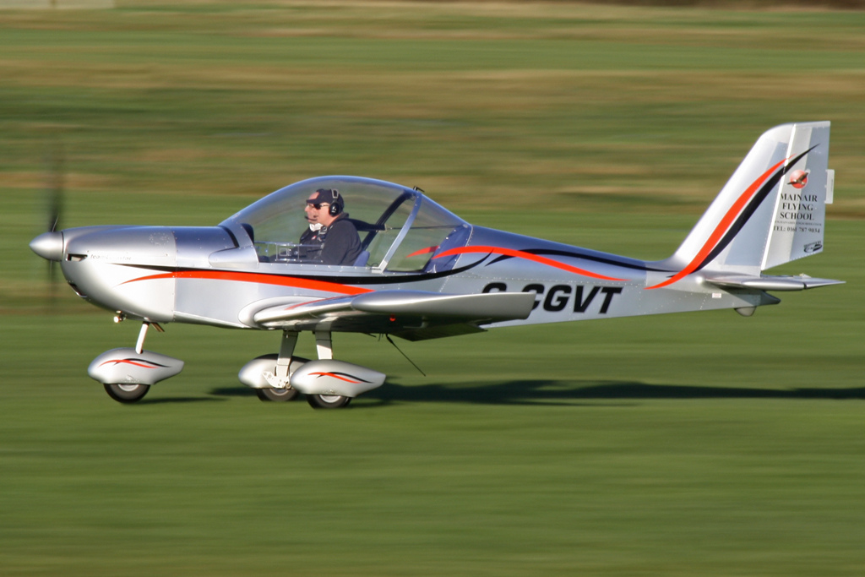
The Standard Into Wind Take Off
Take Off
  Line up on centreline
  Nose wheel straight
  Stick slightly aft of neutral
  Look ahead for reference point
  Release brakes (heels on floor EV-97)
  Smoothly apply full power over 3 seconds

Slide 15
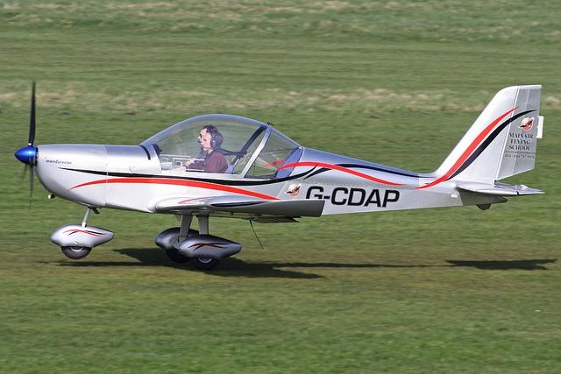
The Standard Into Wind Take Off
Take Off
  Use rudder as appropriate to keep straight
    Anticipate and correct yaw to left with right rudder
  Keep wings level with ailerons
  Confirm full power has been achieved and airspeed is rising
  Apply back pressure on stick to raise nose wheel just above the ground and hold this nose attitude until lift off

Slide 16
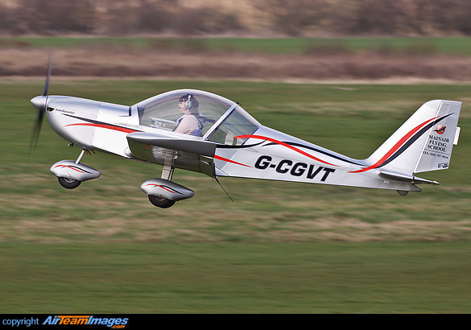
The Standard Into Wind Take Off
Climb Out
  As aircraft lifts off prevent the nose from pitching up
  Adopt shallow climbing angle and accelerate to 70 mph
  Keep wings level with aileron, in balance with rudder
  Aim at reference point to track on centreline of runway

Slide 17
Standard Into Wind Powered Approach
Advantages
  Uses power to accurately control the descent path
  Reduces effects of turbulence and wind gradient
  Less steep – more comfortable for passengers
Approach path controlled by coordinated use of
Power to control descent path (Height)
Elevator (Pitch) to control Airspeed

Slide 18
Standard Into Wind Powered Approach
Circuit planning
  Constantly keep a vigilant look out
  Avoided conflict with other circuit traffic by adjusting airspeed or widen/lengthen circuit as appropriate
  Flatter descent for powered approach compared to glide approach
On Base Leg initiate descent
  Allow for drift
  PAT to achieve 70 mph and 1st Flaps (ensure airspeed below Vfe)
  Adjust power (medium low) to establish correct approach angle

Slide 19
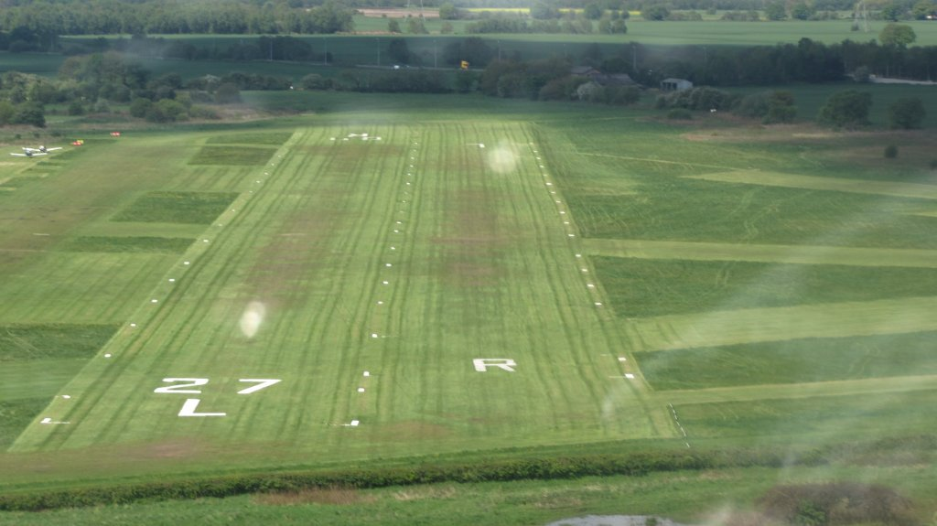
Standard Into Wind Powered Approach
Turn onto Final
  Look long and low before turning
  Judge the turn so you line up on the extended runway centreline
Establish Final approach
  Correct airspeed (60 mph EV-97)
  Landing flaps set
  Medium low power setting
Reference Point
Pick an aiming point
  Aim at reference point on the runway (just after the runway numbers)

Slide 20
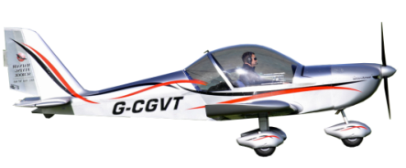
Standard Into Wind Powered Approach
The reference point should stay stationary in your view
If reference point is rising in your field of view then you are sinking below the approach path
  Increase power and raise the nose a little
Planned approach path

Slide 21
Standard Into Wind Powered Approach
If reference is descending in your field of view then you are rising above the approach path
  Reduce power and lower the nose a little
Planned approach path

Slide 22

Round Out
Maintain the correct airspeed (60mph EV-97, 55KT C42)
At approximately 30 feet above the ground
  Transfer your gaze from the aiming point to the far end of the runway
  Easy back on the stick to end up in a level attitude approximately 3 feet (1 metre) above the ground
approach

Slide 23
Hold Off
Reduce the power to idle
  (This may have been done earlier to maintain correct approach path)
As airspeed reduces ease back on the stick to raise the nose to balance any tendency to sink
  (This increases AOA which counters the loss in lift due reducing airspeed)
Maintaining hold off height accurately involves developing both skill and judgement through practice
Maintain runway centreline using small aileron inputs to counter any drift

Slide 24


Hold Off - Common Issues
Height judgement – refine skills, remember to look ahead
Not holding off long enough
  Landing too fast, difficult to control, possibly nose wheel first
  Patient required – wait for nose attitude to be correct for touch down
Ballooning at round out
  Too much backward pressure on stick
  If airspeed sufficient, check pressure on stick and wait for aircraft to settle to correct height and continue with hold off
Ballooning in hold off
  Too high and slow airspeed – GO AROUND

Slide 25
Touch down
Continue to hold off, allowing aircraft to lower towards ground - HAVE PATIENCE
Ensure aircraft is tracking down runway
  Use rudder to align fuselage
  Ailerons to control lateral drift
Aim to touchdown with airspeed at a minimum
  Stick being nearly fully back
  Nose high attitude (the Flare)
  Nose wheel clear of the runway

Slide 26
Roll Out
Once on ground:
  steer with rudder
  maintain back pressure on stick until nose wheel lowers
Brake gently if necessary
Once at safe taxi speed vacate runway
  Post landing checks
  ATC clearance to taxi

Slide 27
Additional Comments
Basic principles of the circuit applies to all airfields
  Standard circuits are LH unless informed otherwise
  Circuit heights at other airfields may vary between 500’ and 1000’
  Remember that the QFE pressure setting is used in the circuit

